Slide 1

CSC496: Deep learning in computer vision Prof. Bei Xiao
Lecture 1: Introduction

Slide 2
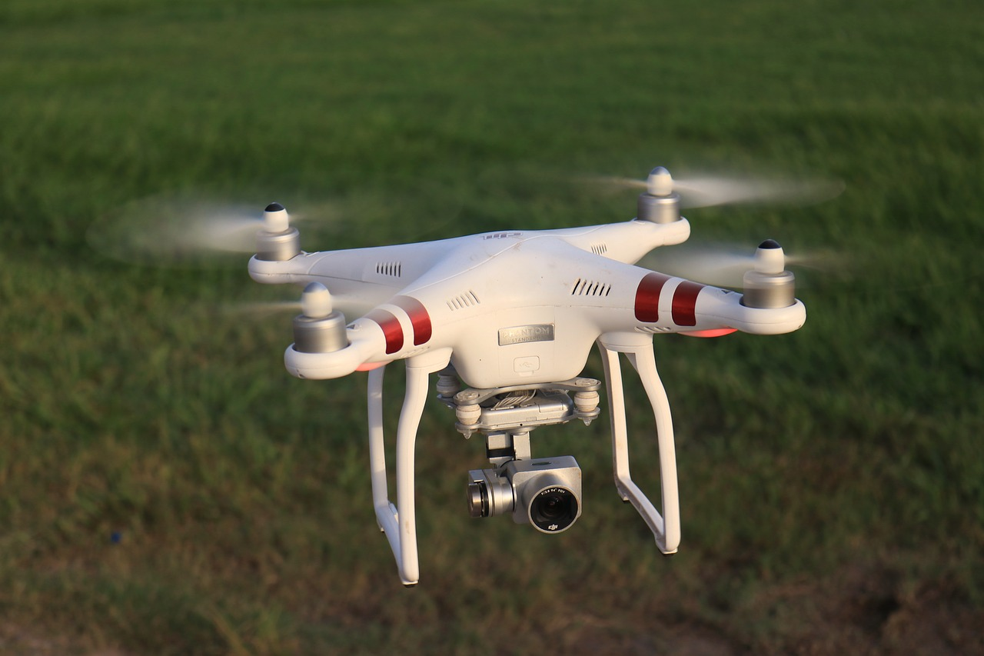
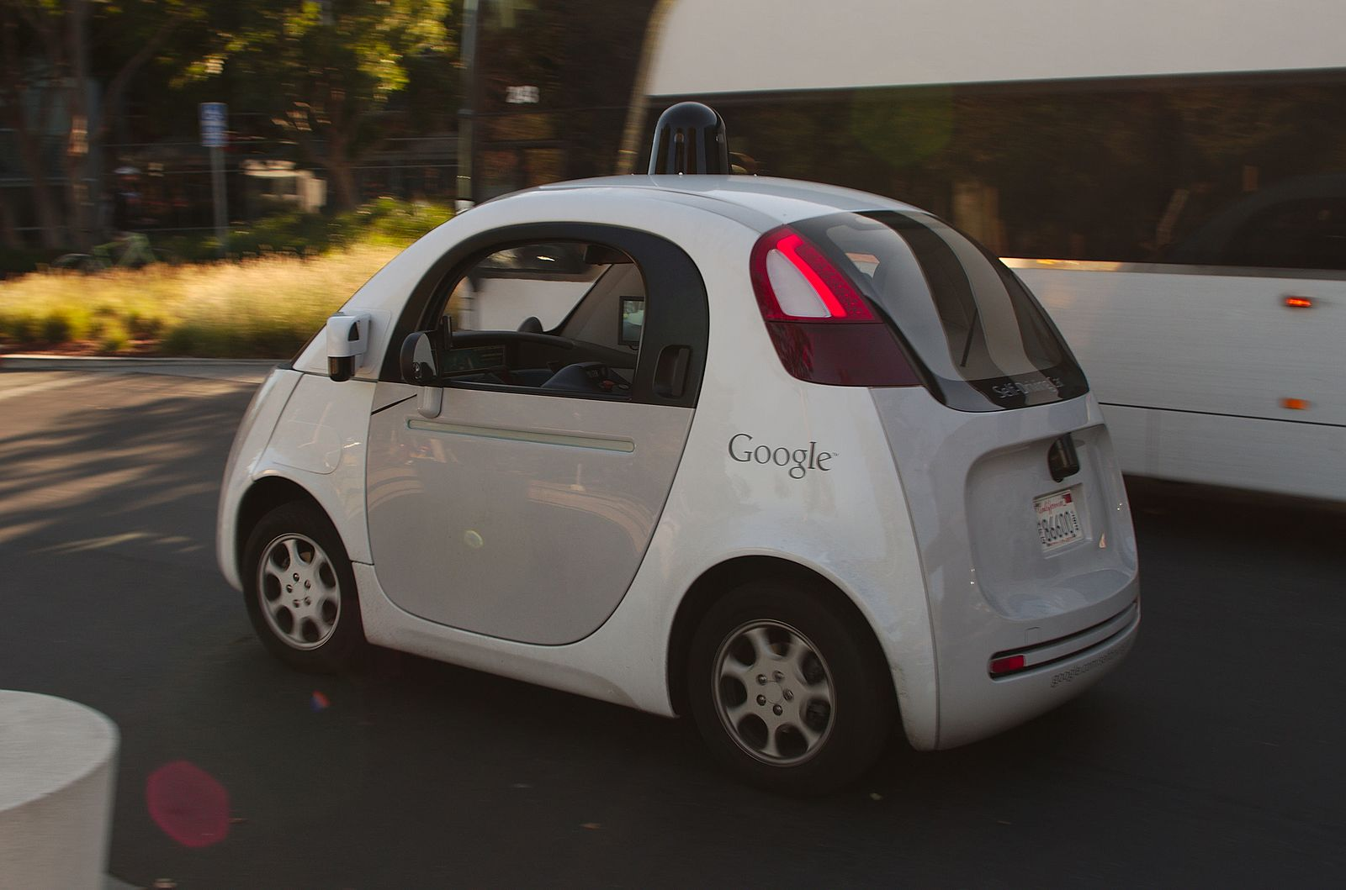
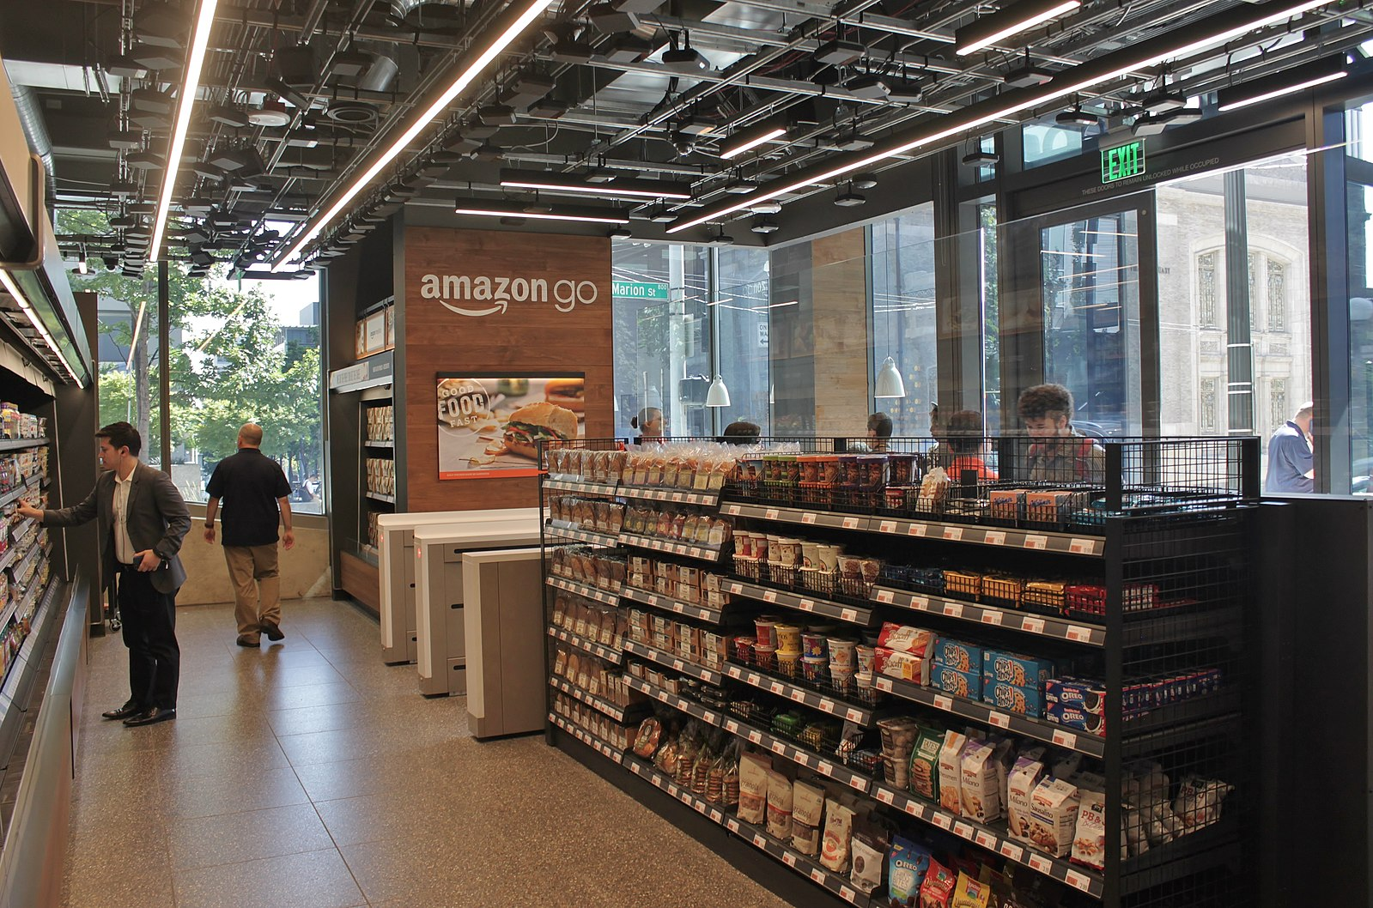
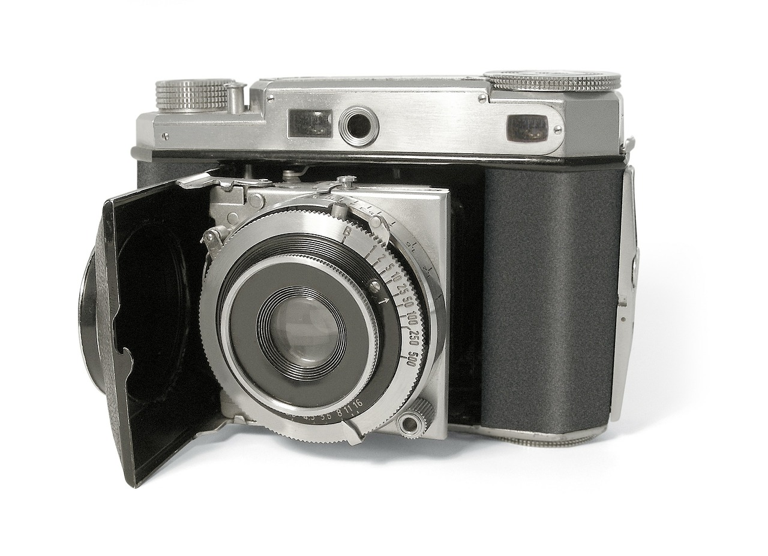
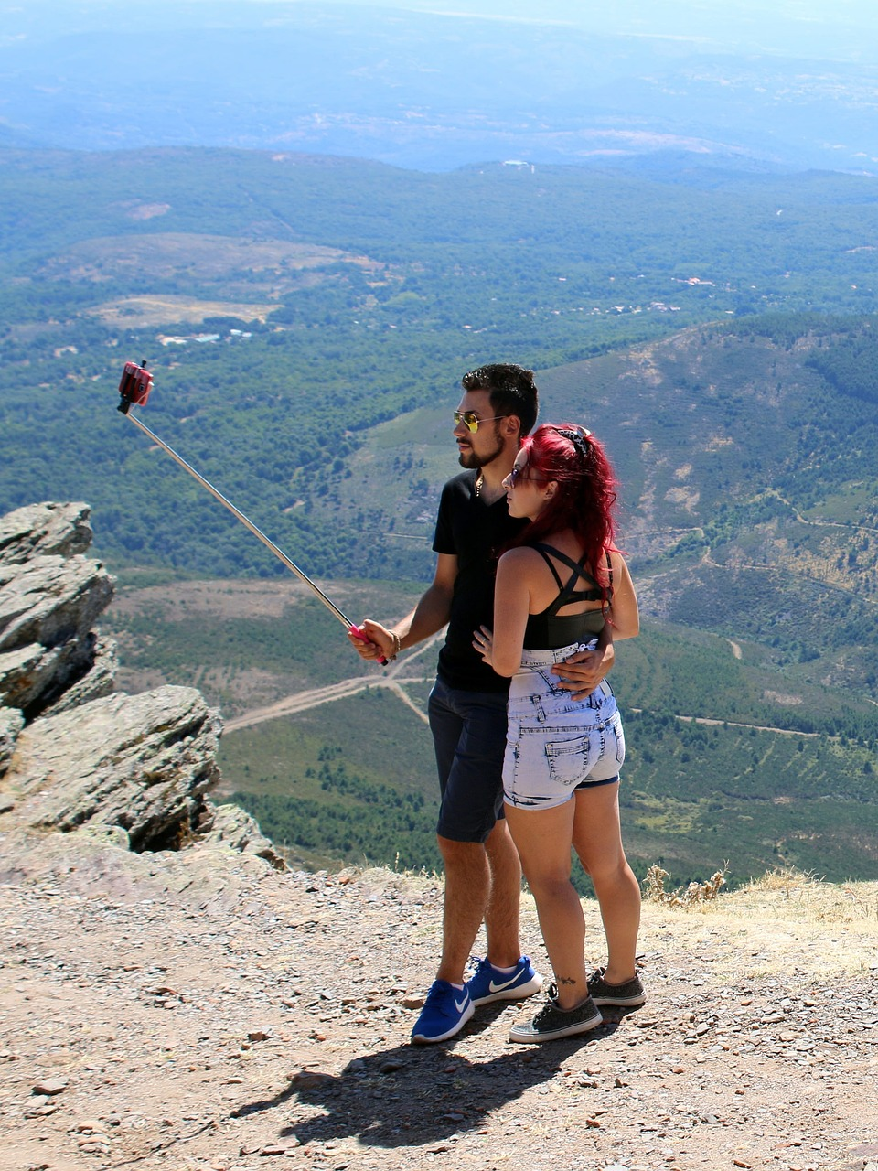
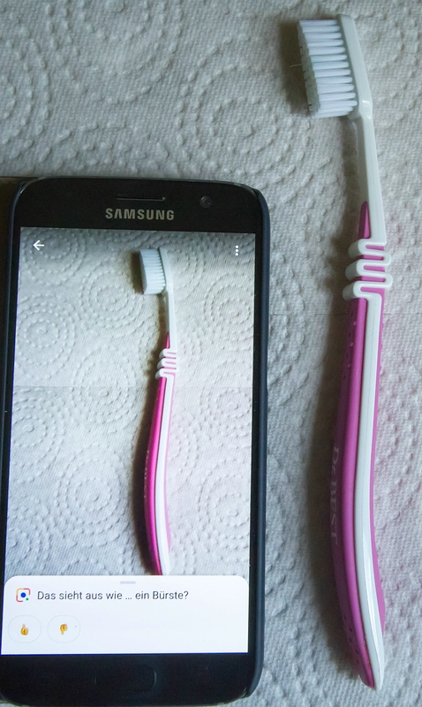
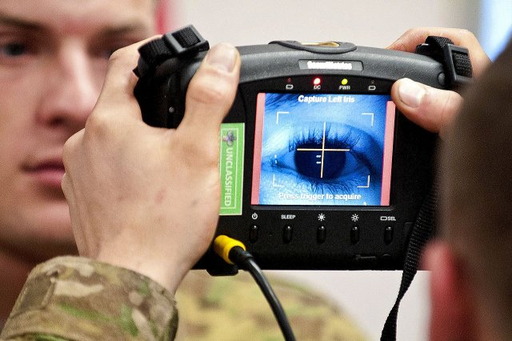
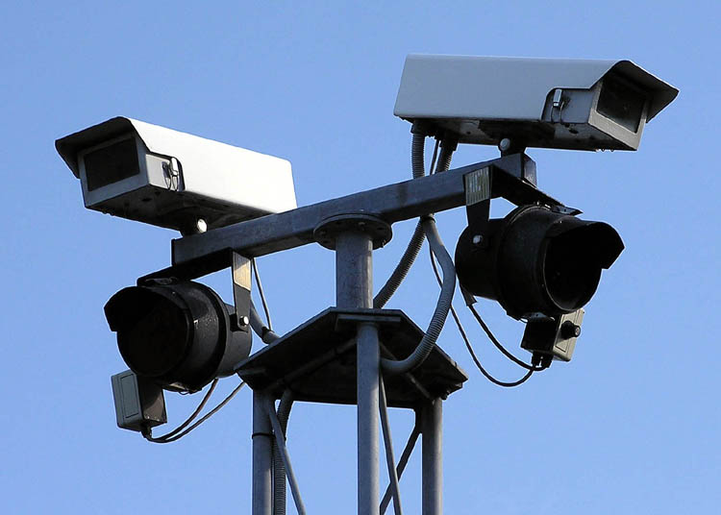
Welcome to CSC 496

Slide 3
Overview
What is computer vision?
History of computer vision
What is deep learning?
Instructor/student Introduction
About this course

Slide 4
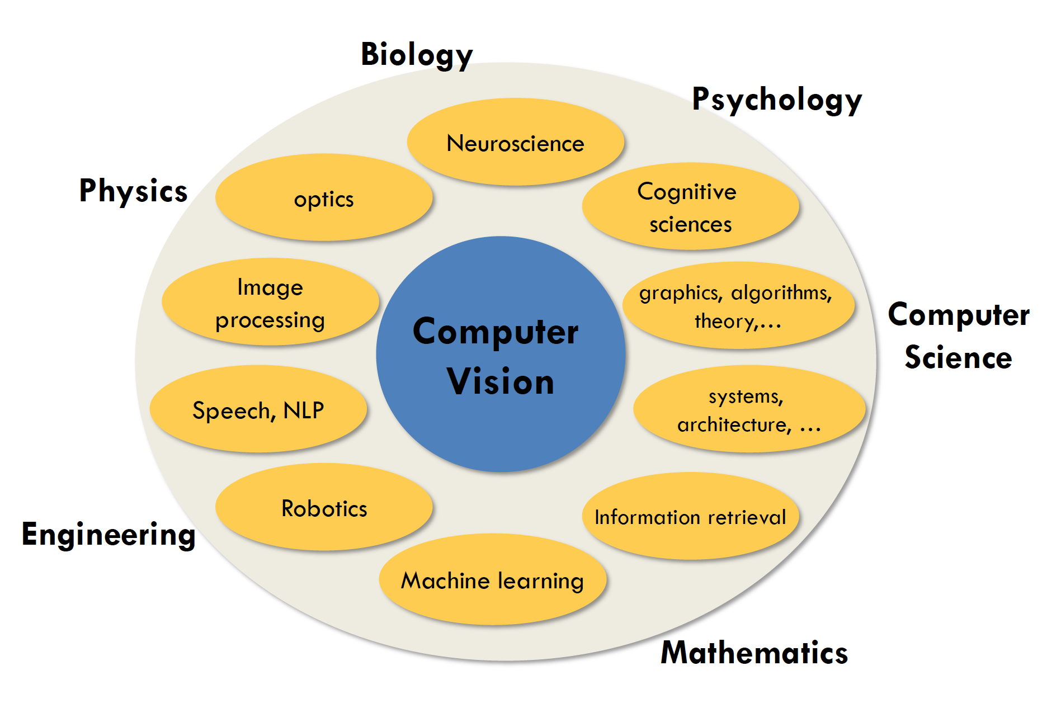
Slide from Stanford cs231n

Slide 5
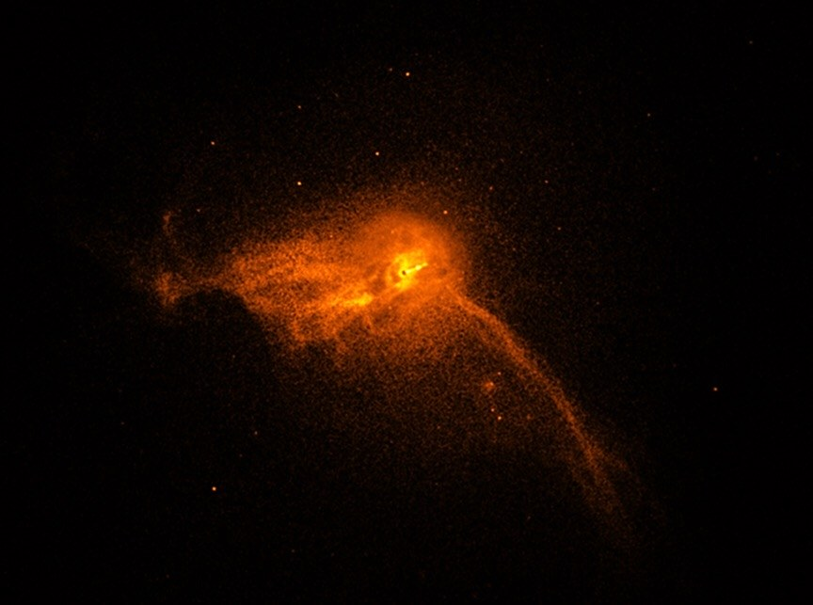
Astrophysics: Imaging the black hole
https://www.jpl.nasa.gov/edu/news/2019/4/19/how-scientists-captured-the-first-image-of-a-black-hole/

Slide 6
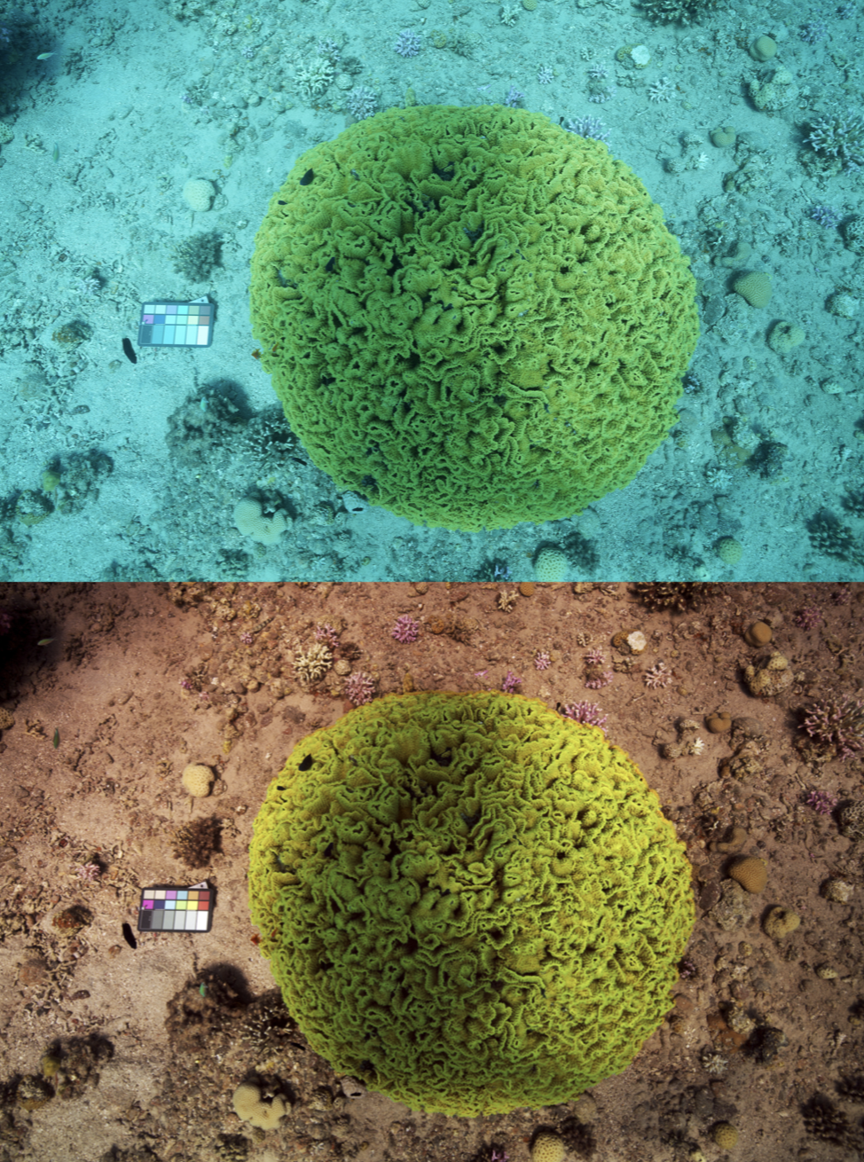
Fun application: remove water from underwater imaging
Akkaynak et al. 2019 CVPR

Slide 7
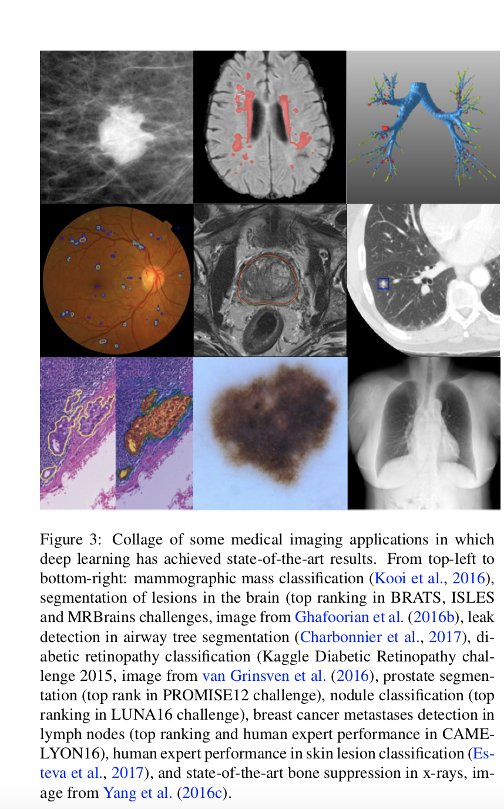
Medical imaging: classifying cancer

Slide 8
Landmarks in computer vision

Slide 9
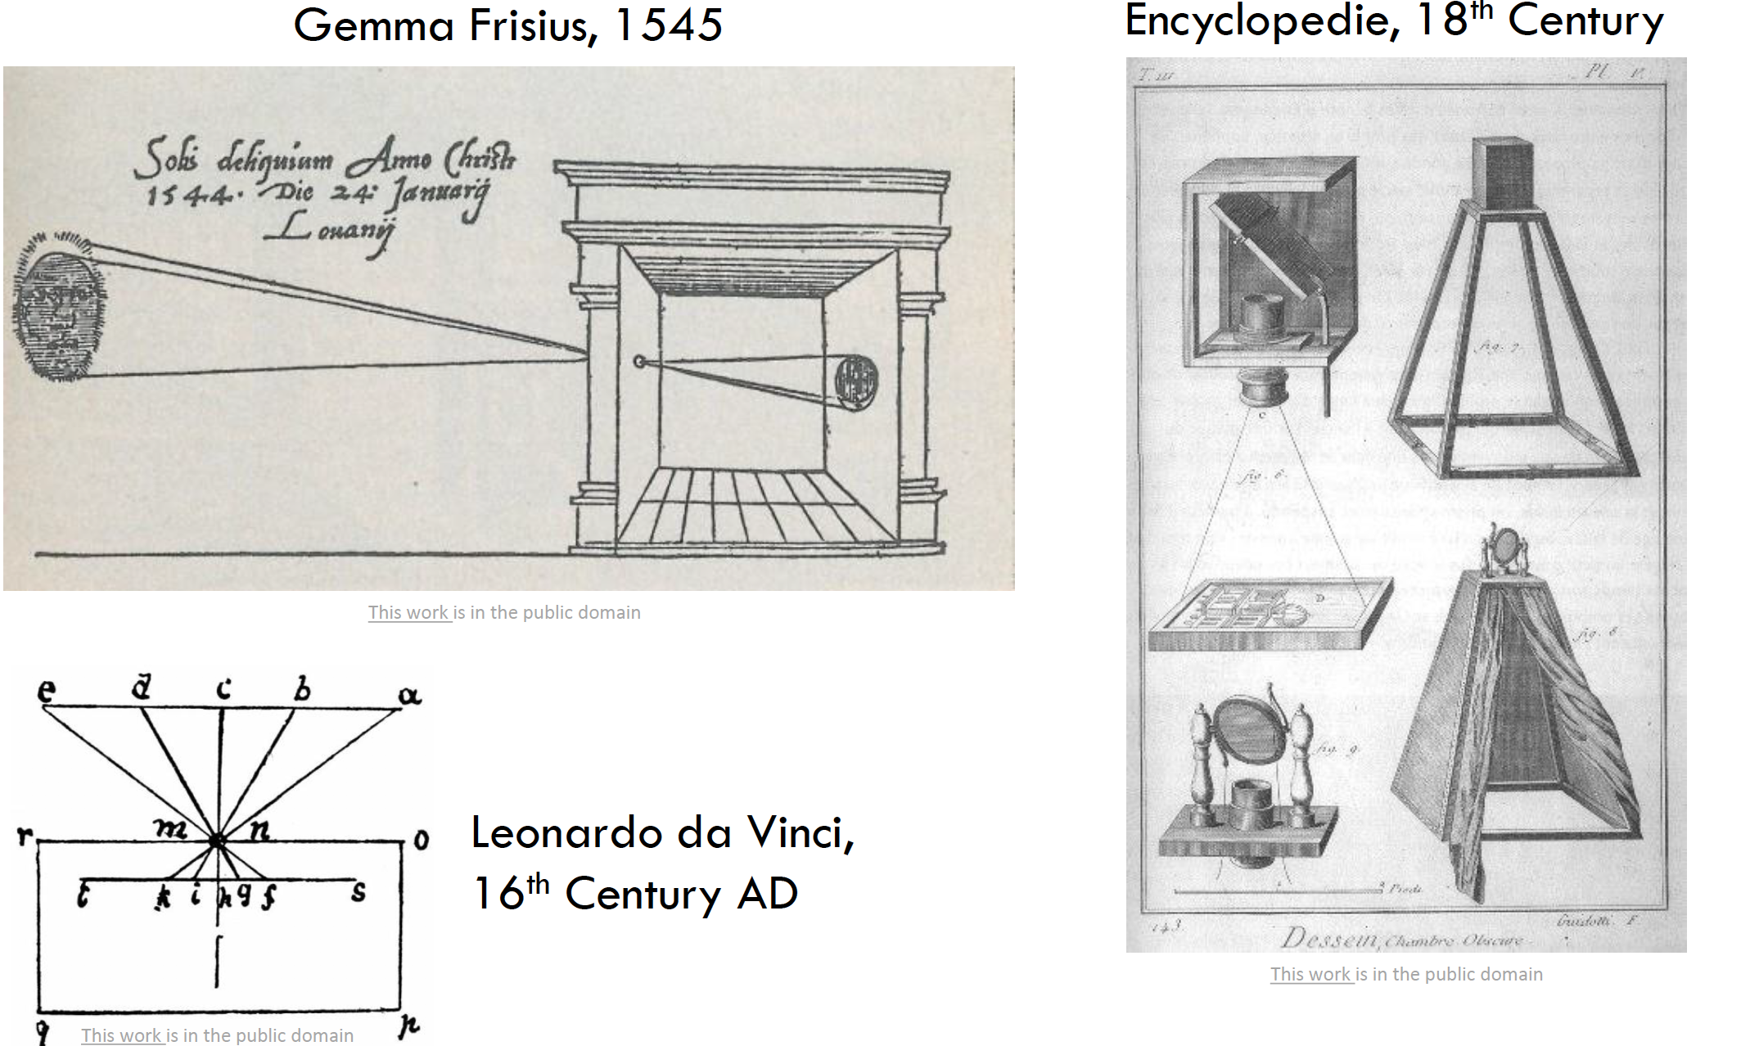
Camera Obscura (pinhole camera)

Slide 10
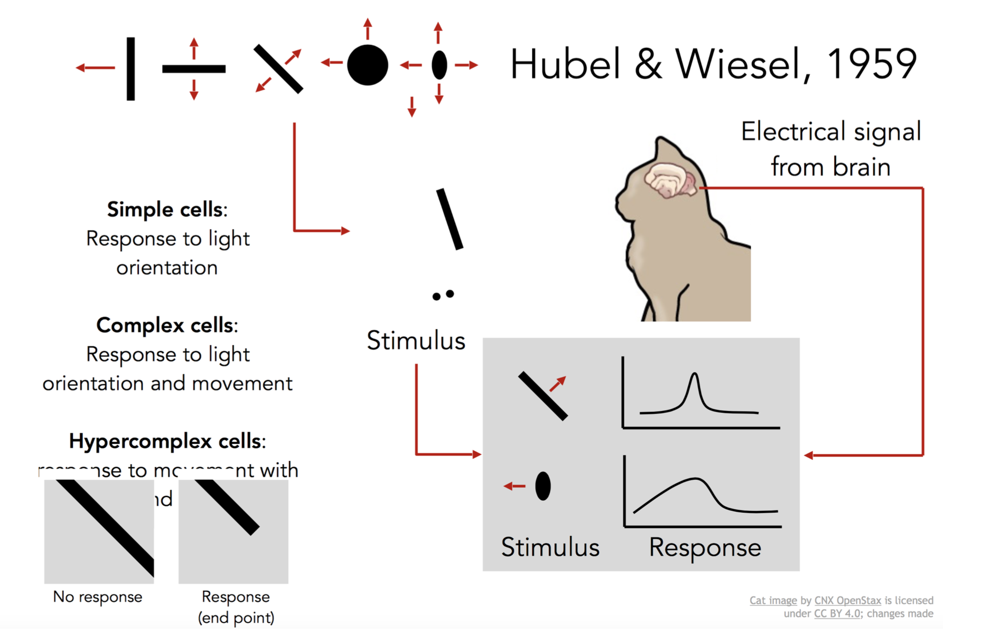
Visual Neuroscience, Nobel Prize 1962
Slide from Fei-Fei Li, Justin Johnson, Serena Yeung, cs231 Stanford

Slide 11
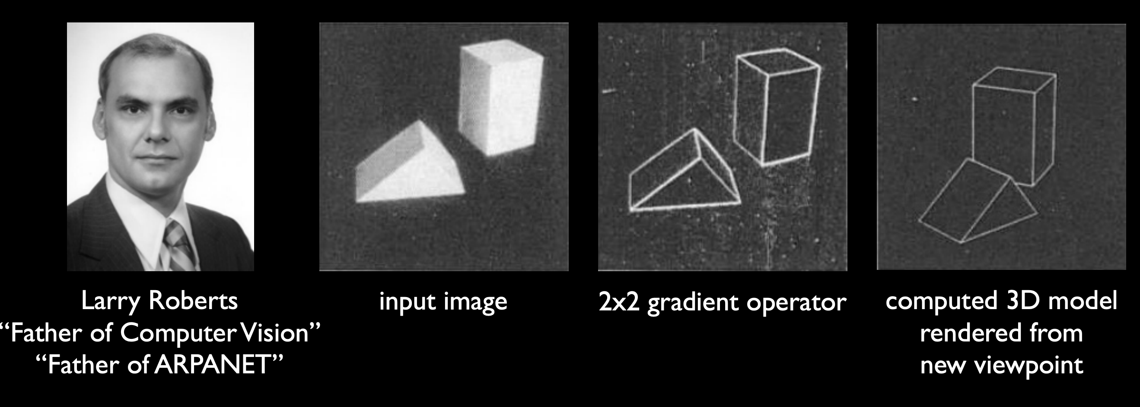
Block world Larry Roberts, 1963
Slide from Steve Setiz

Slide 12
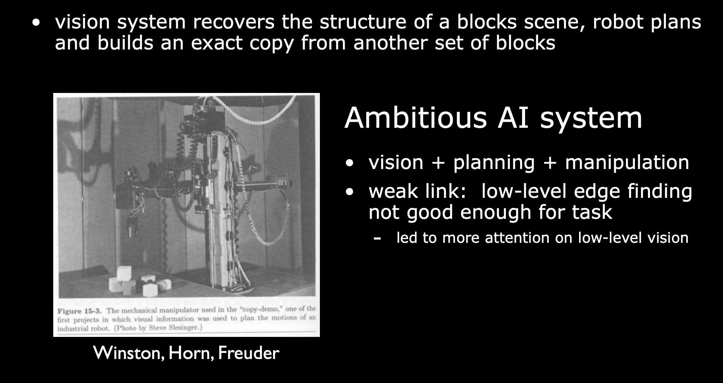
Block world ++ Culmination: 1970 Copy-demo at MIT
Slide from Steve Setiz

Slide 13
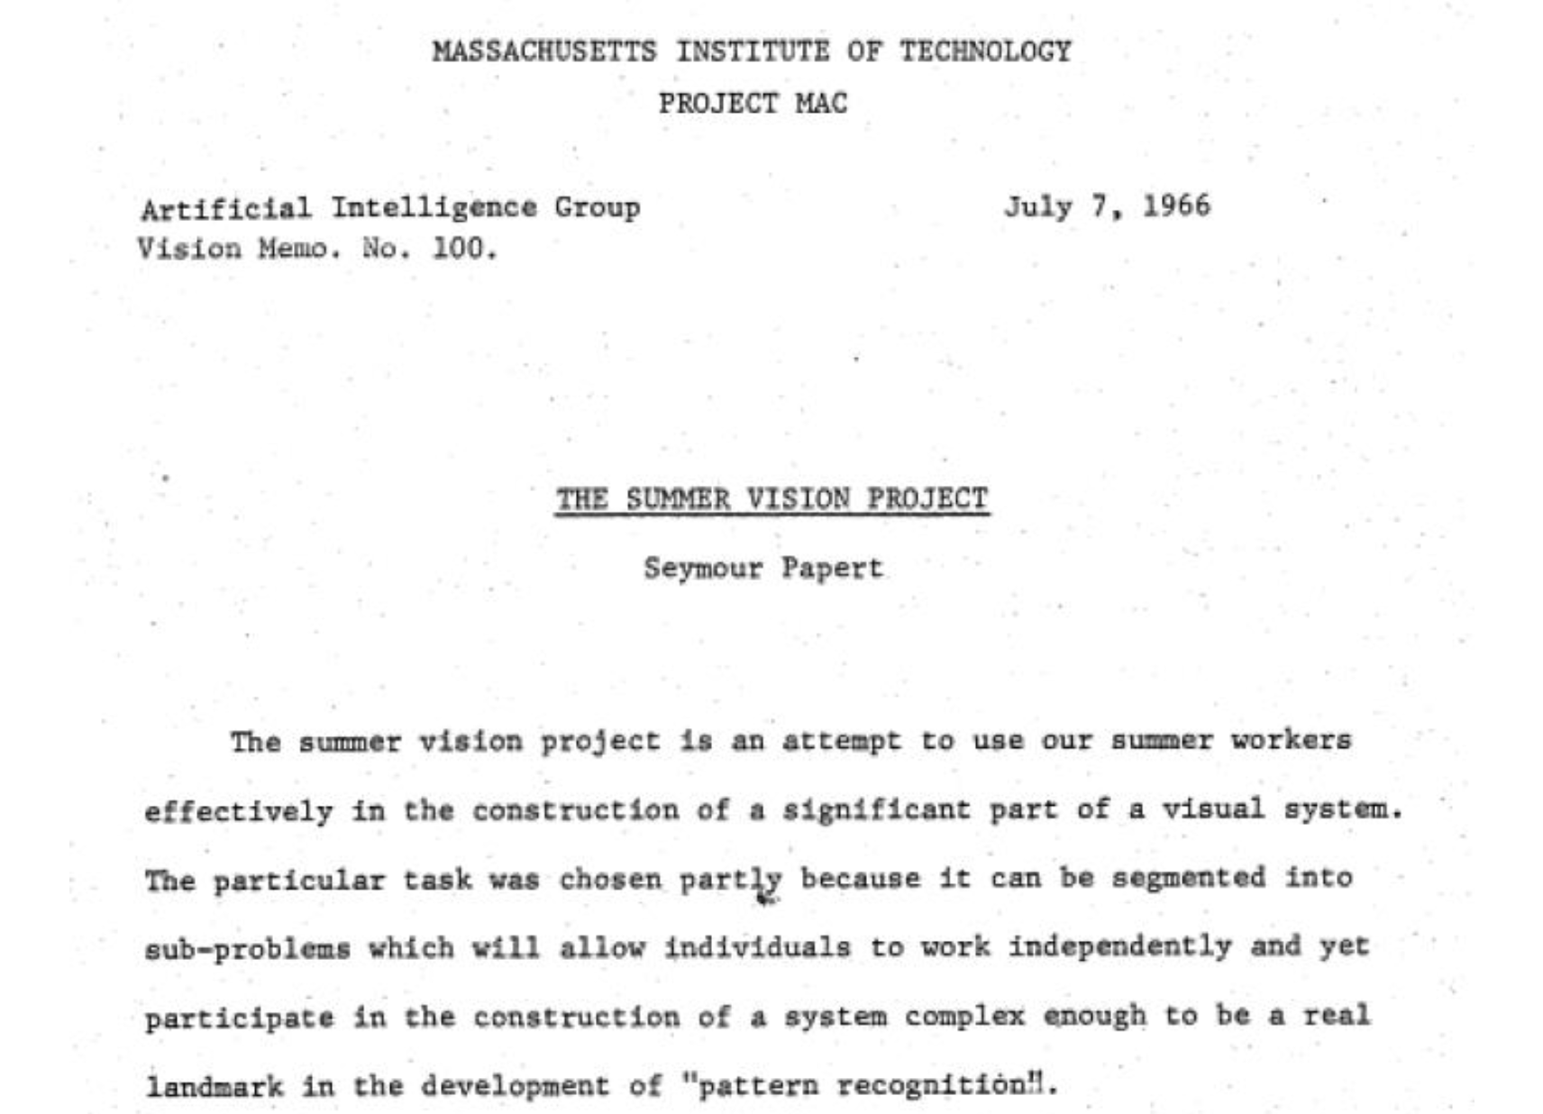
Summer project: 1966

Slide 14
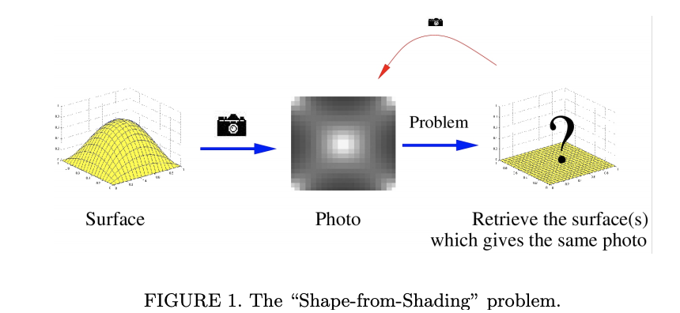
Shape from shading: 1970

Slide 15
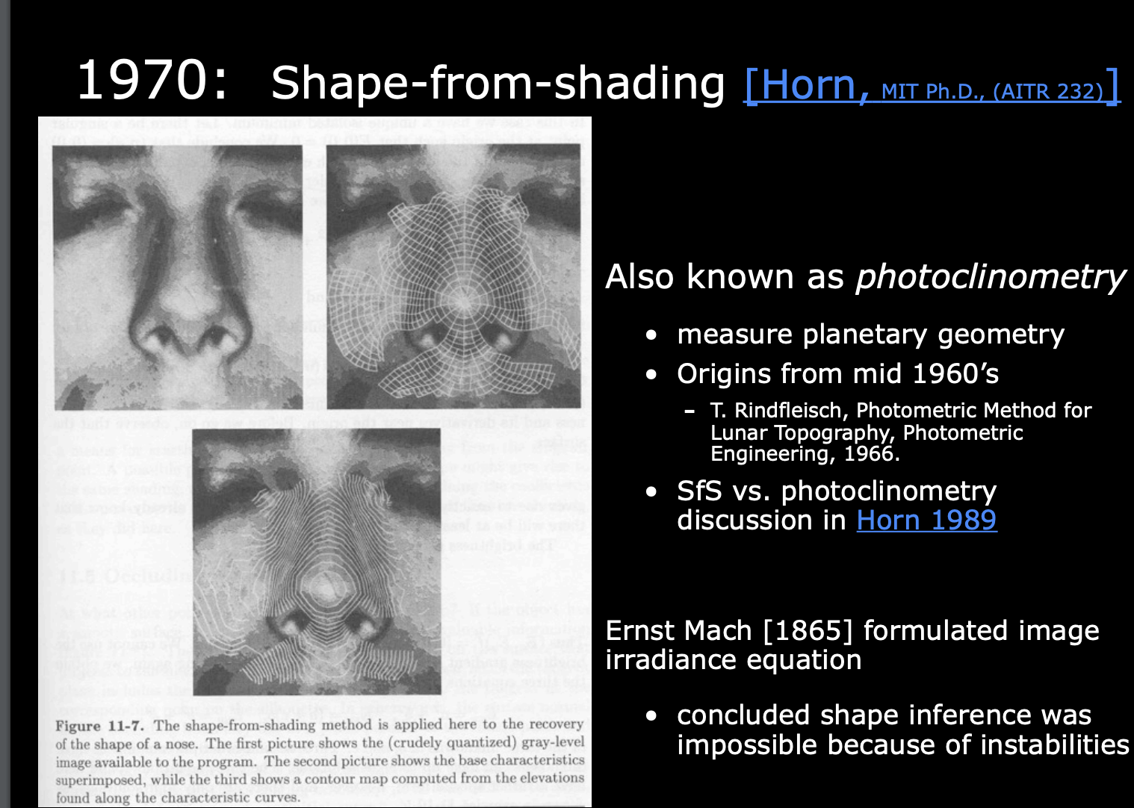
Shape from shading: 1970
Slide from Steve Setiz

Slide 16
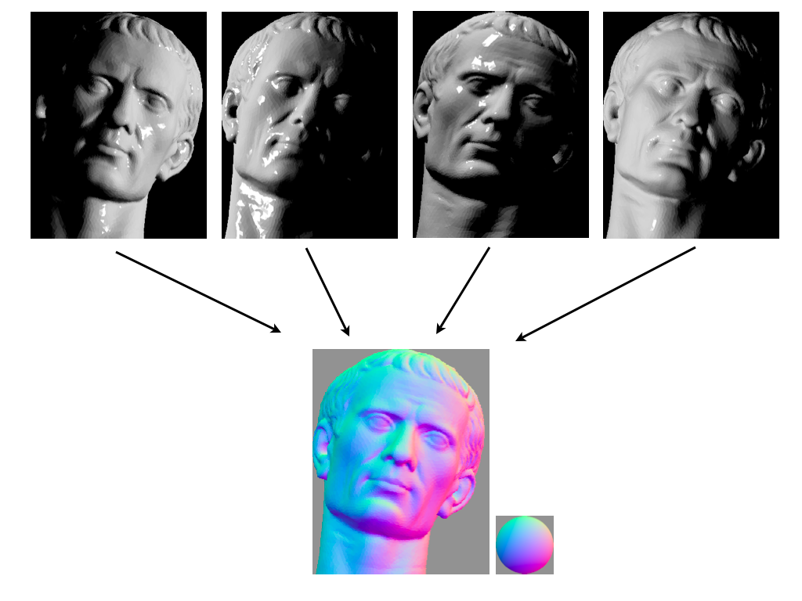
Photometric stereo

Slide 17
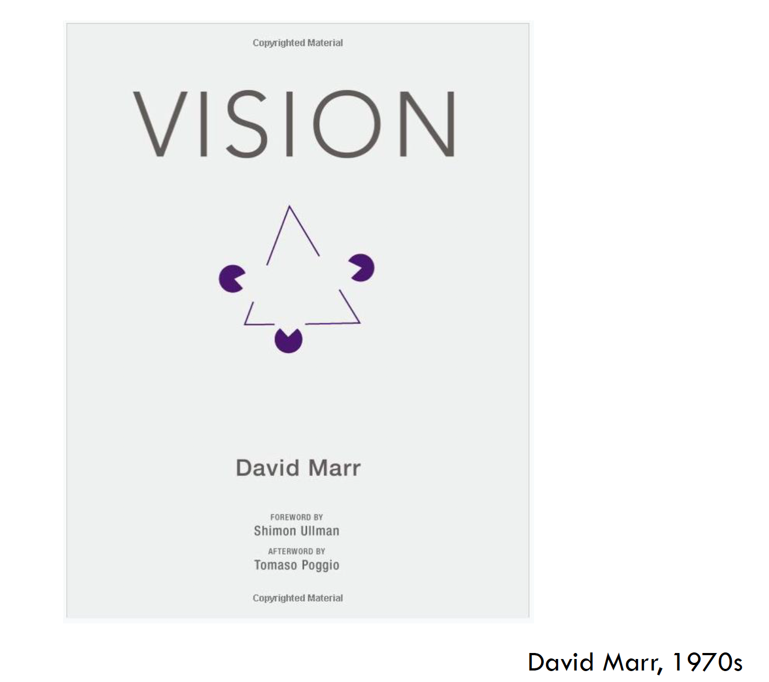

Slide 18
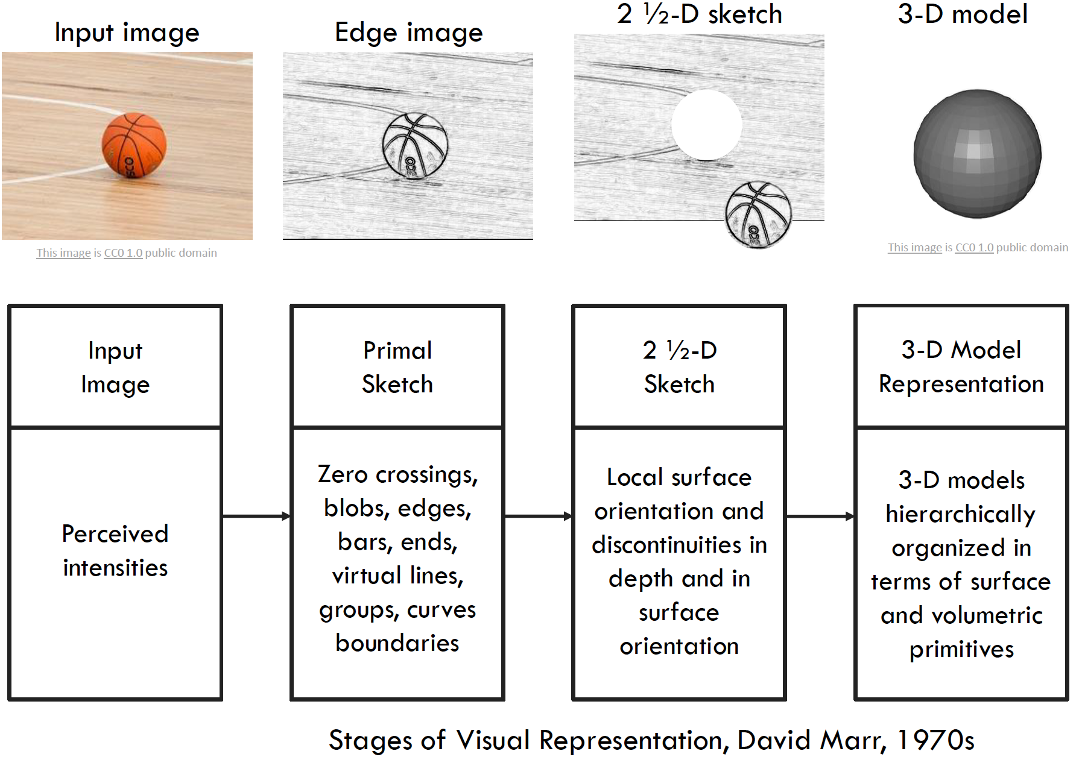

Slide 19
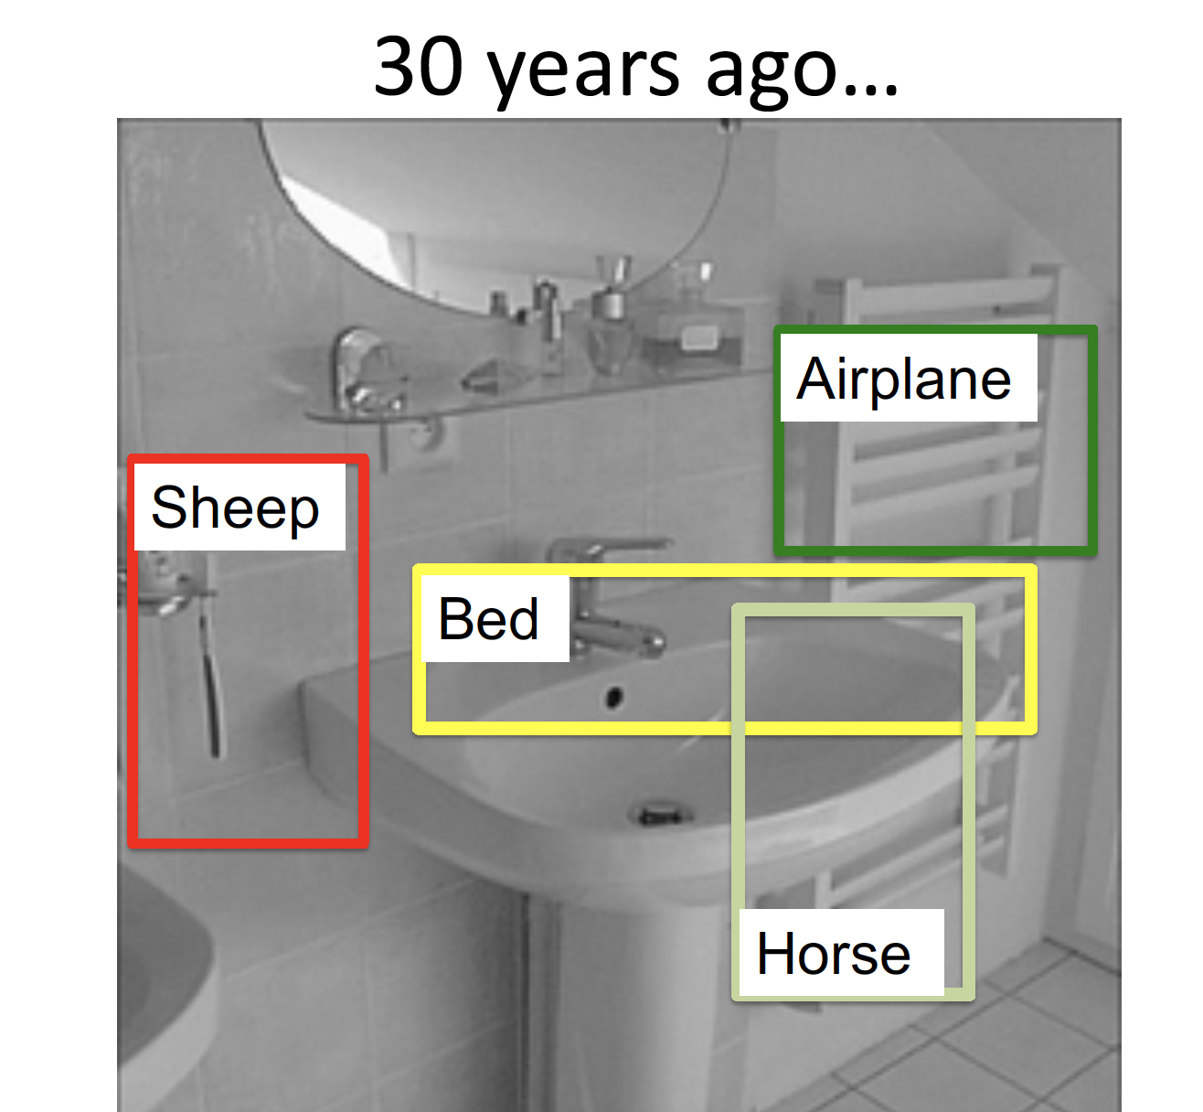

Slide 20
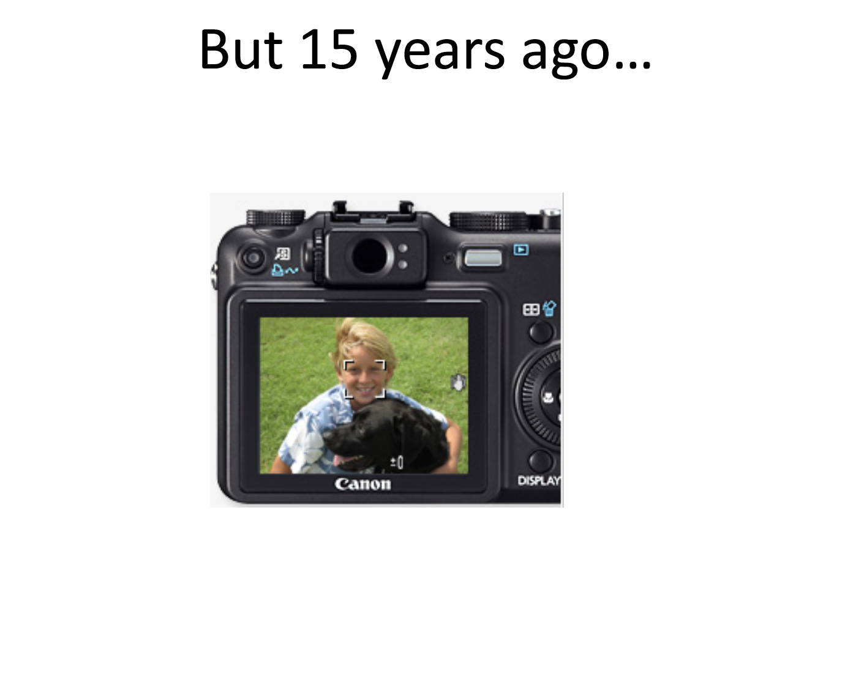

Slide 21
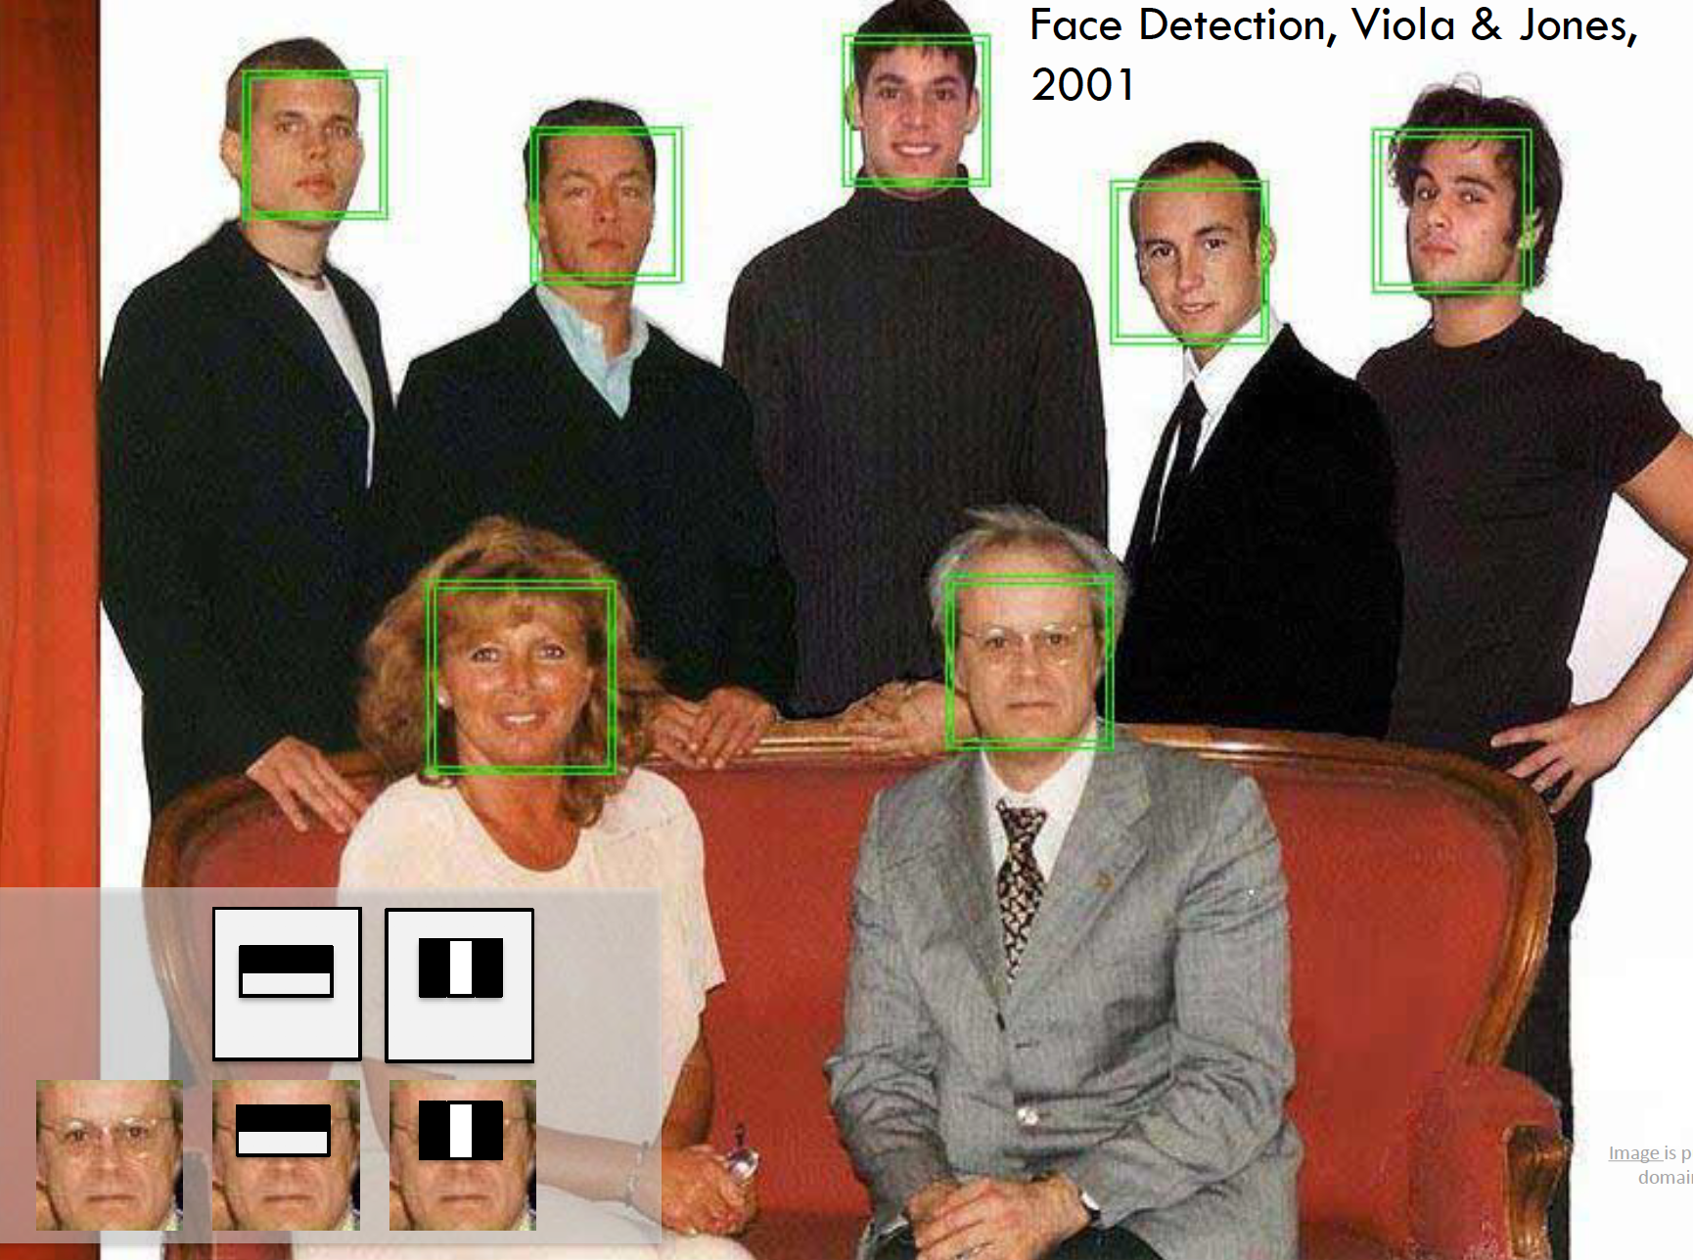
Robust Real-time Object Detection
- Viola * Jones, 2001

Slide 22
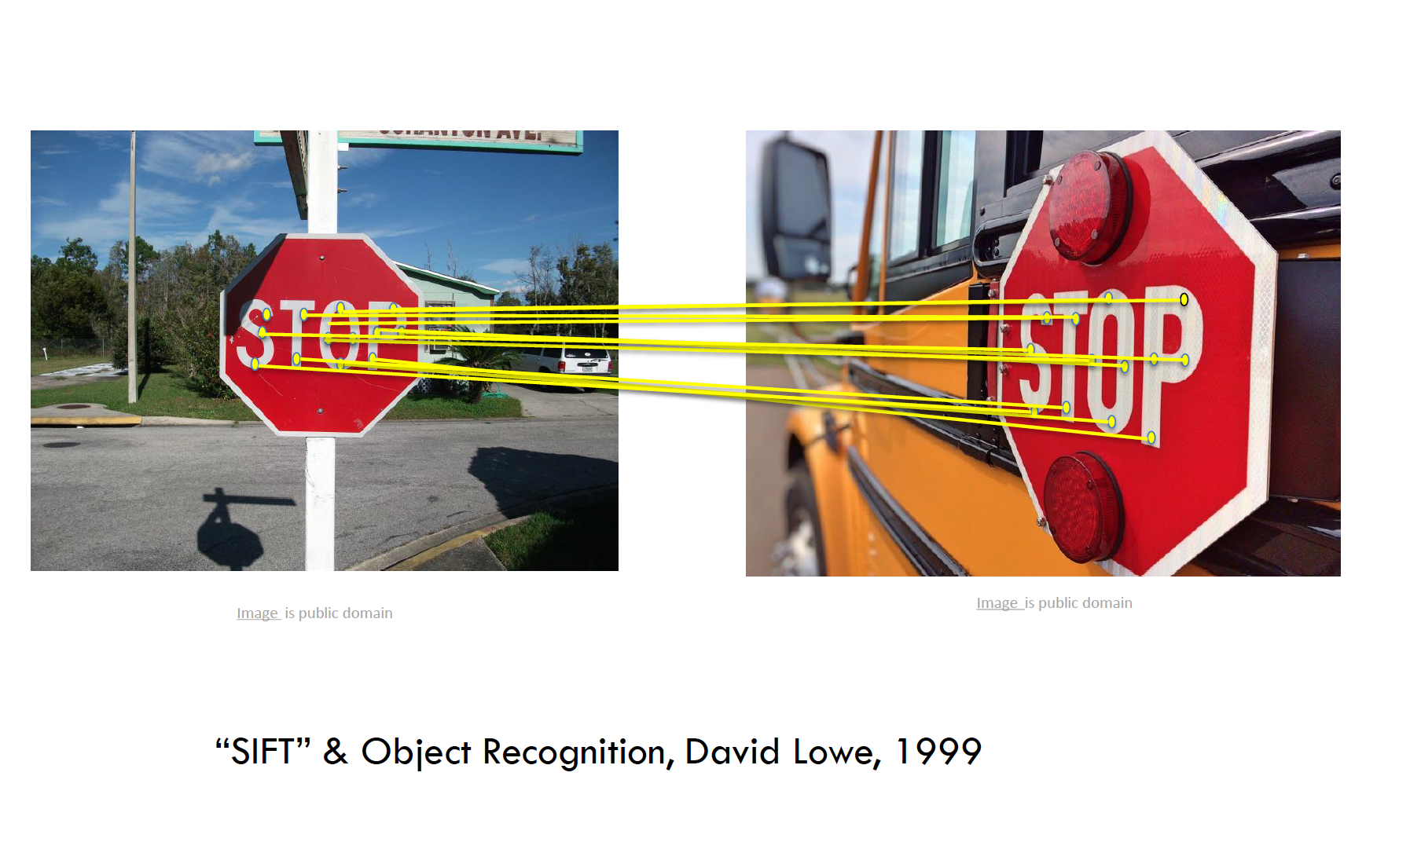

Slide 23
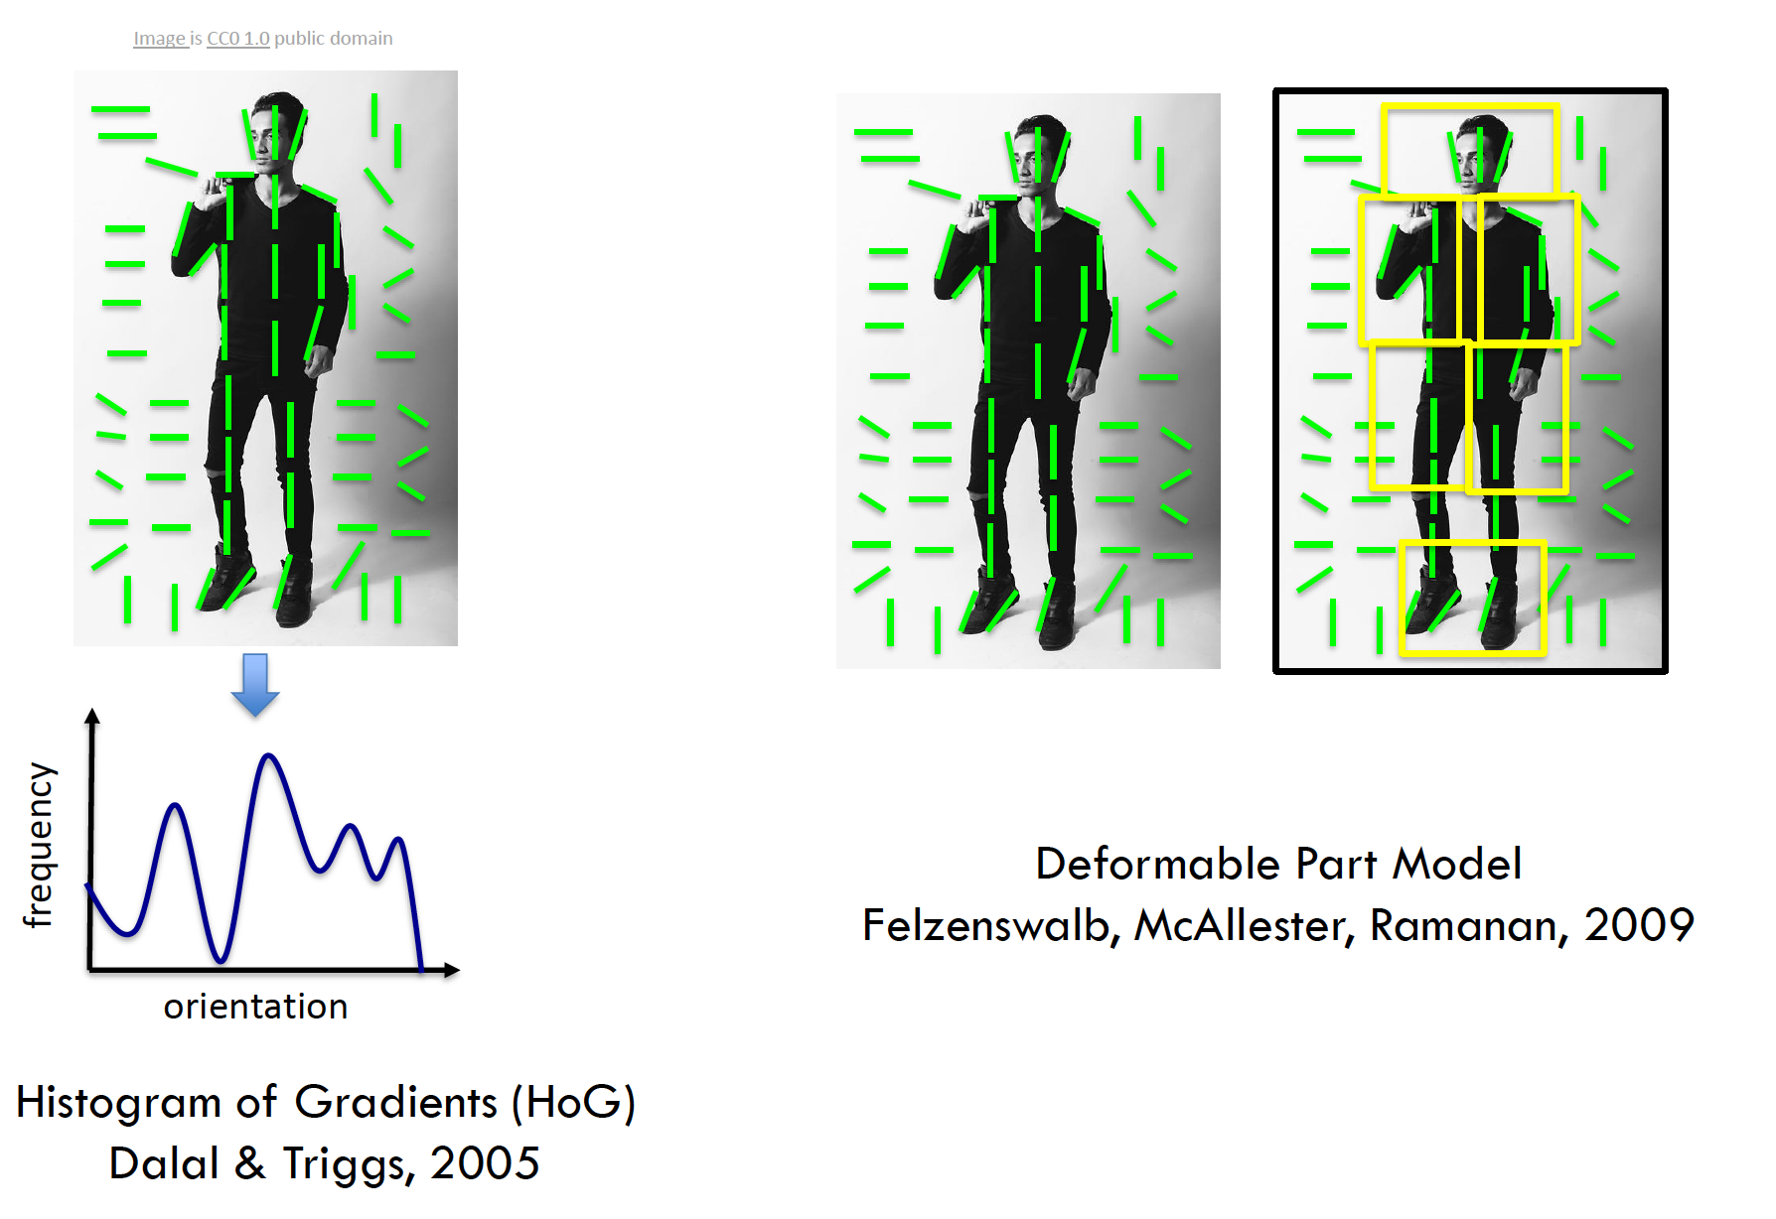

Slide 24
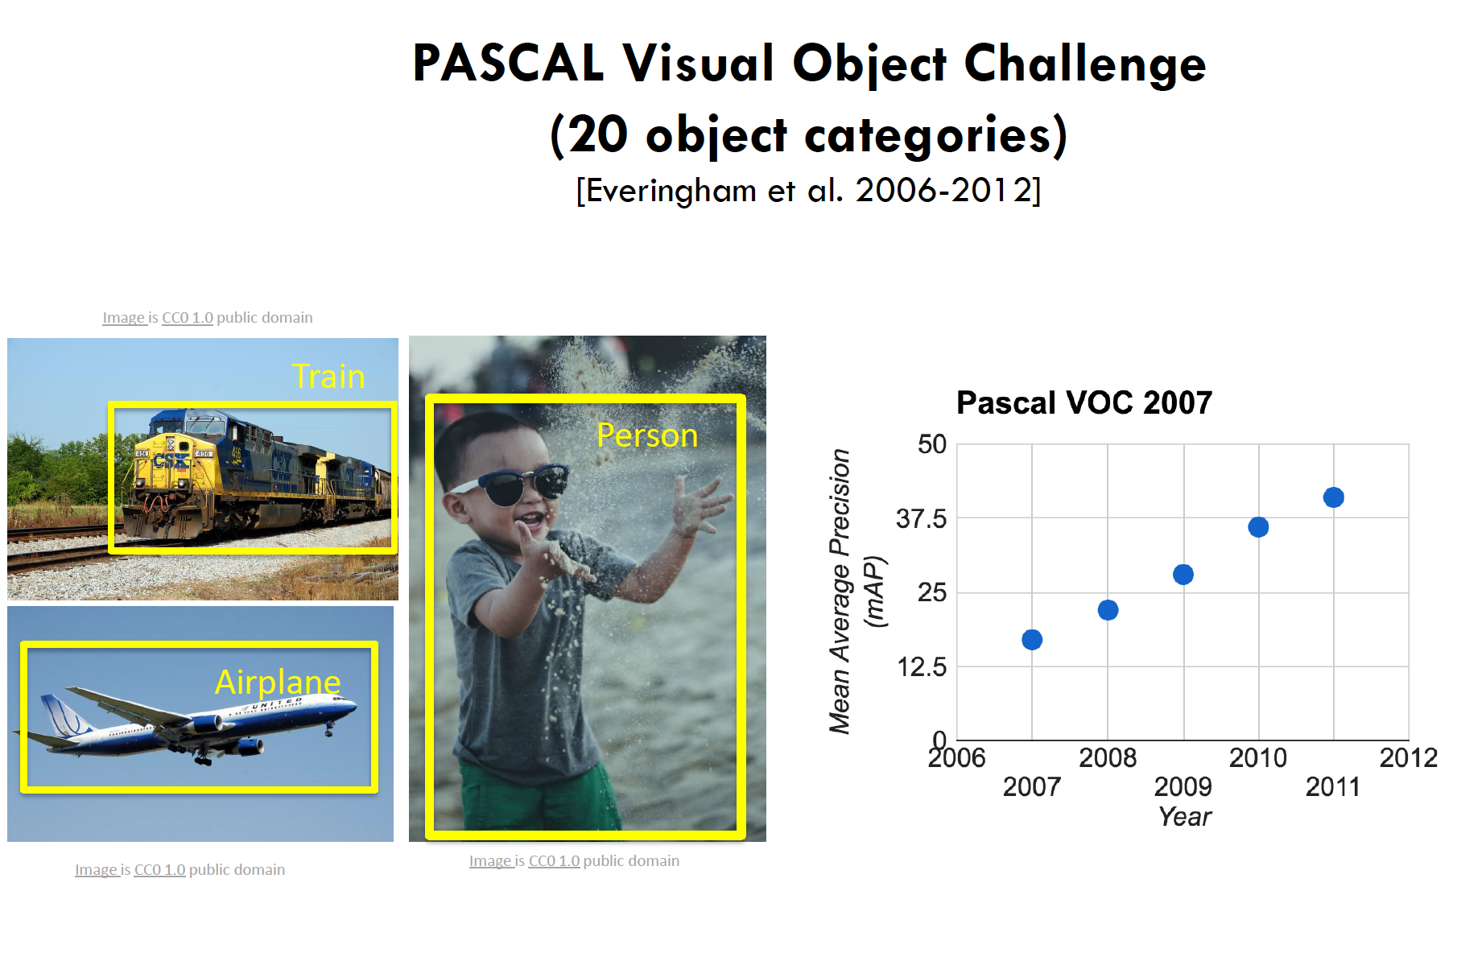

Slide 25
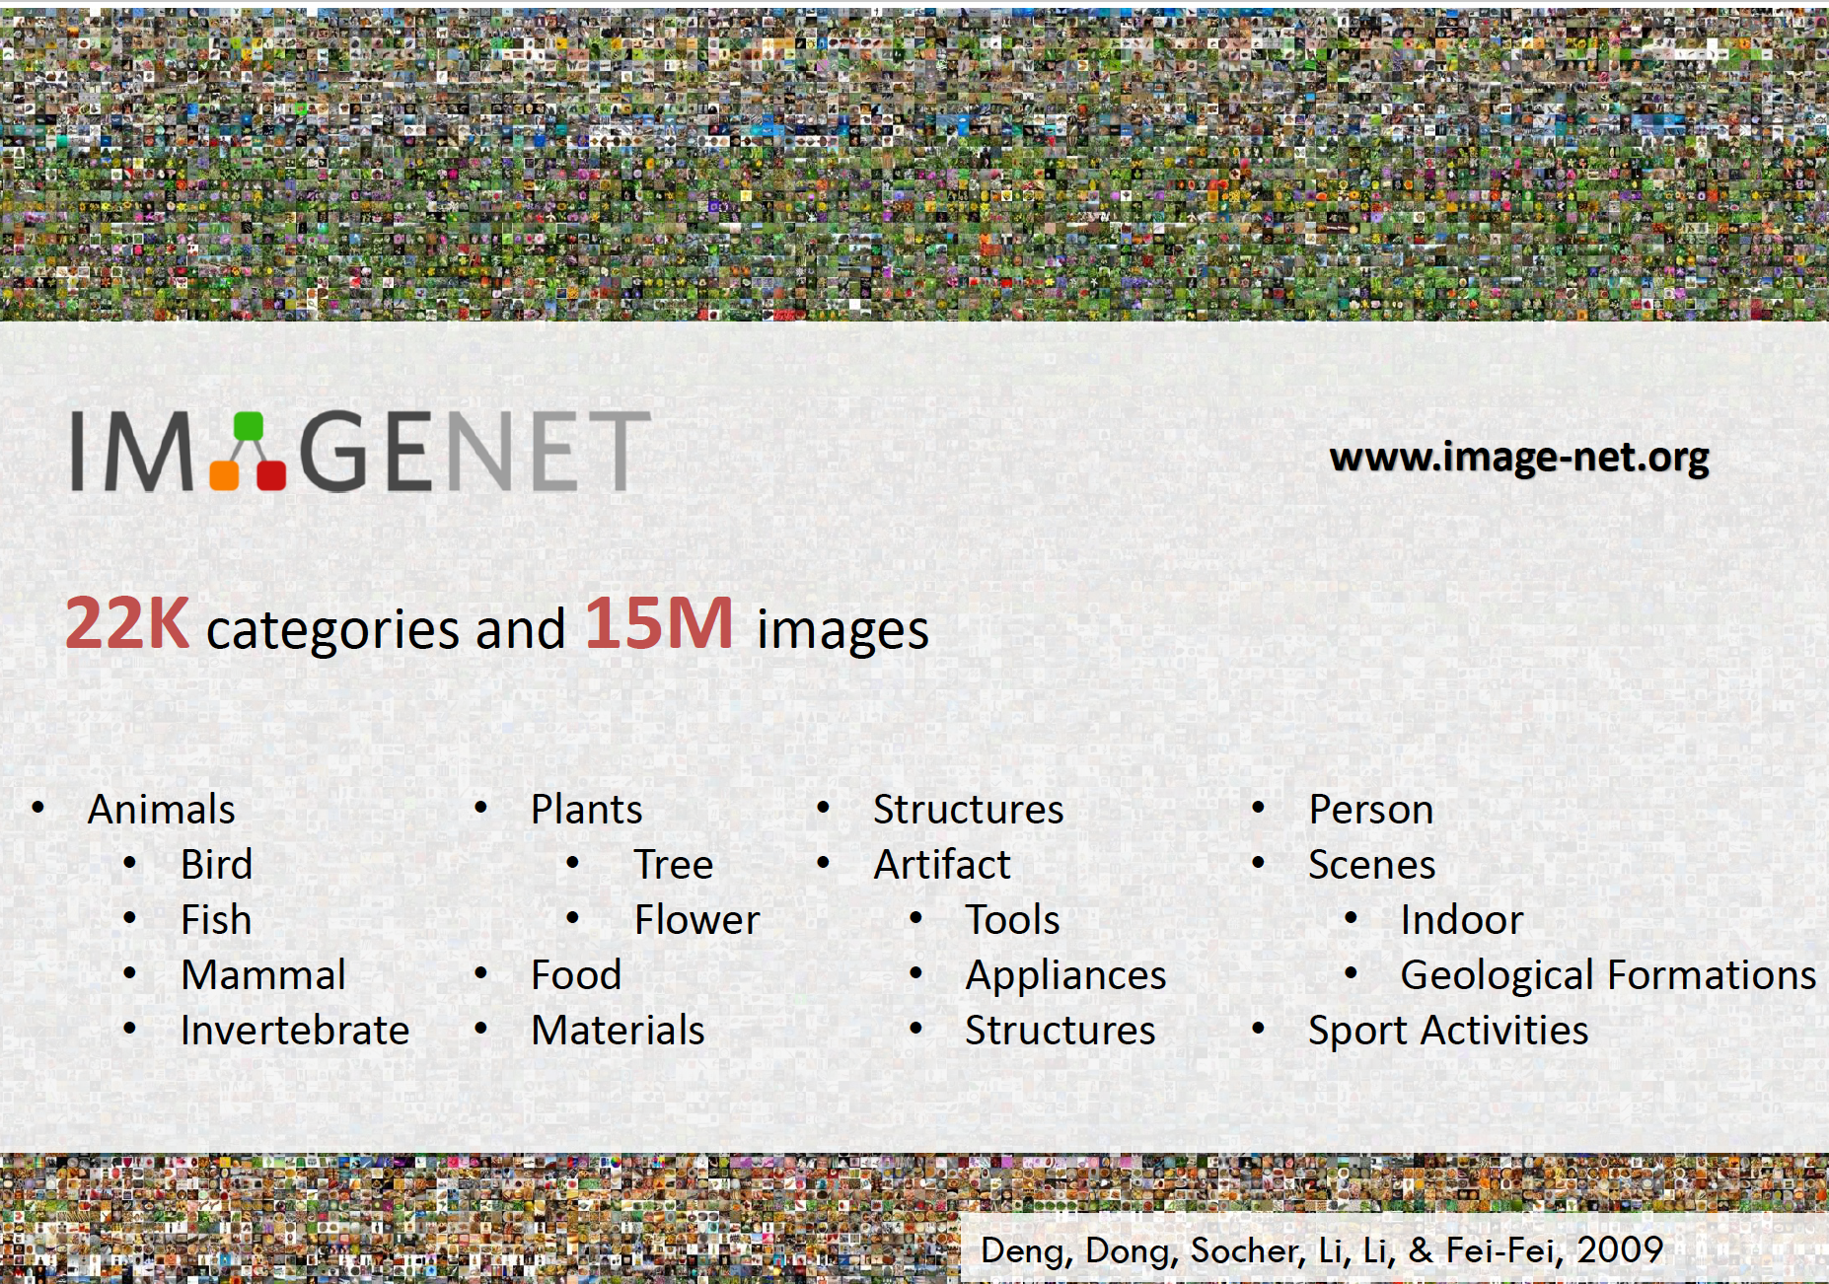

Slide 26
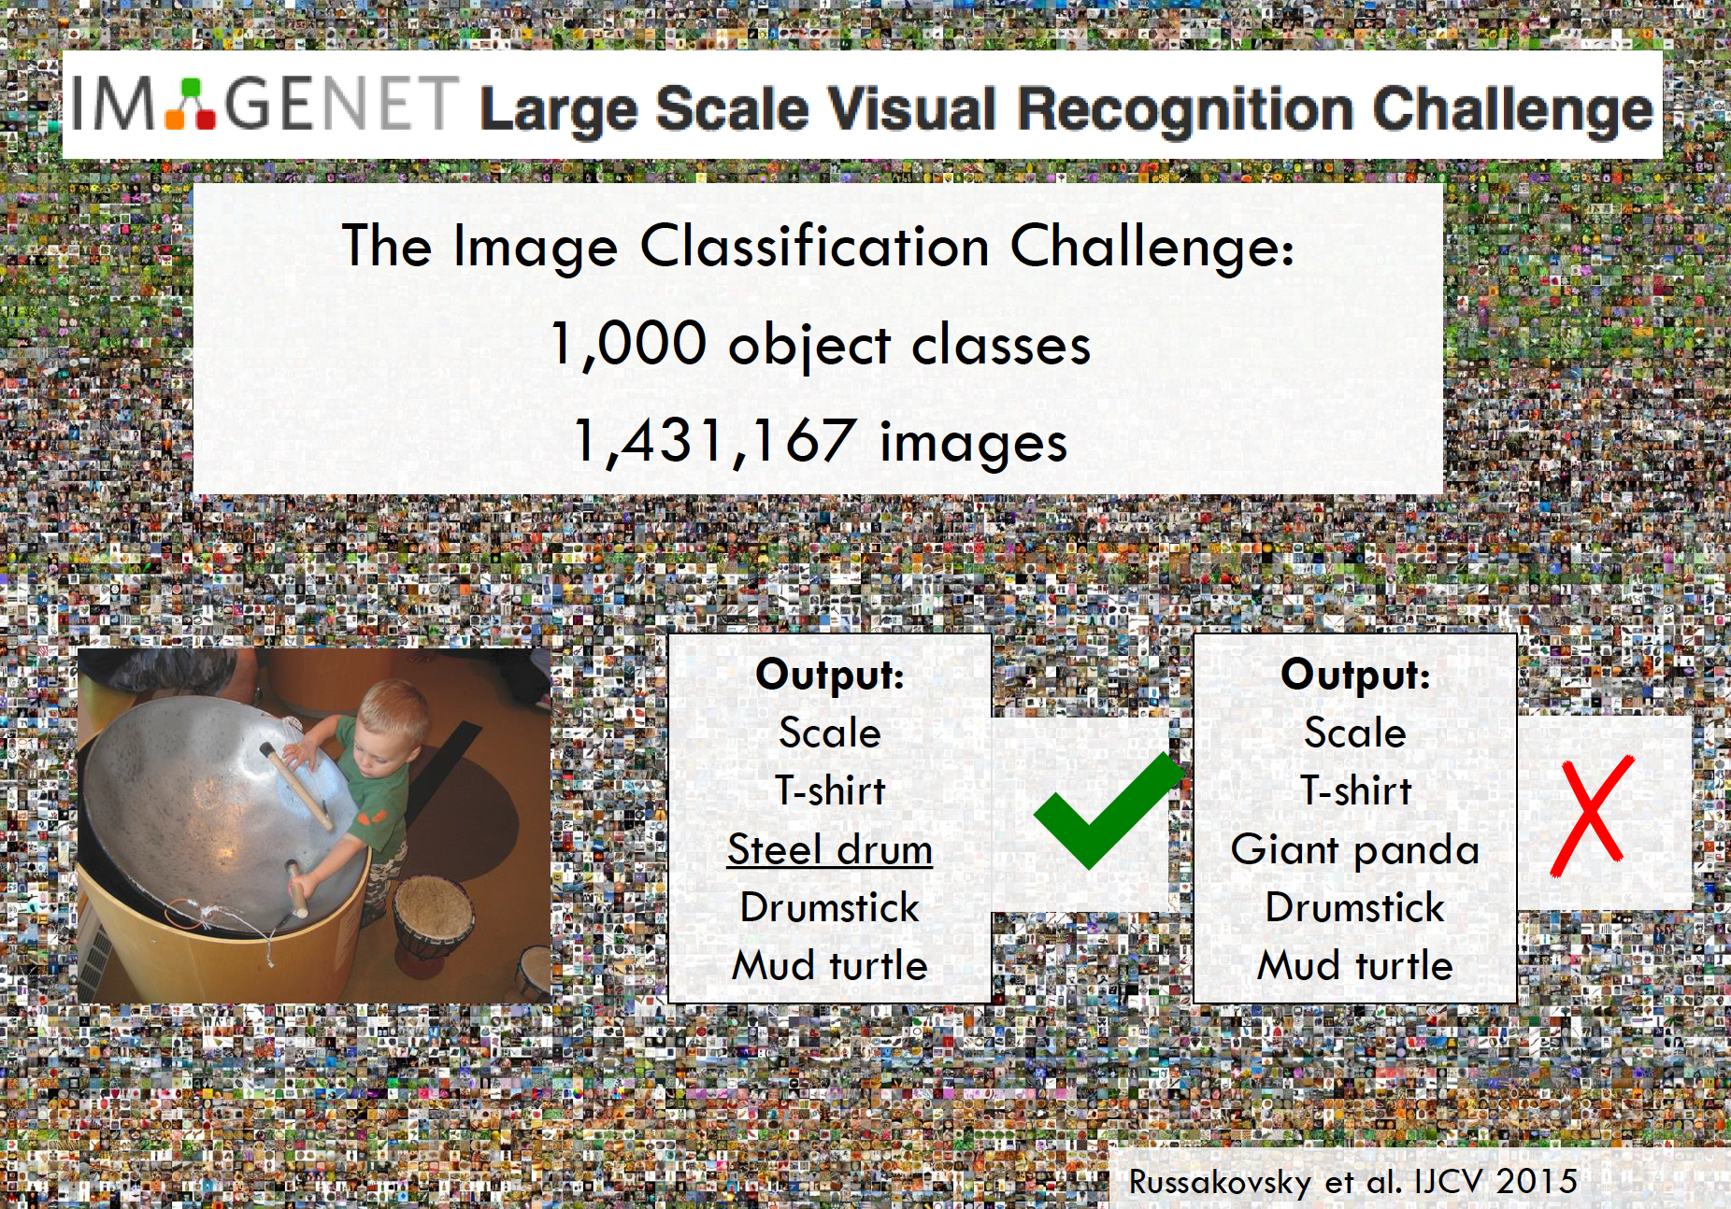
https://arxiv.org/pdf/1409.0575.pdf

Slide 27
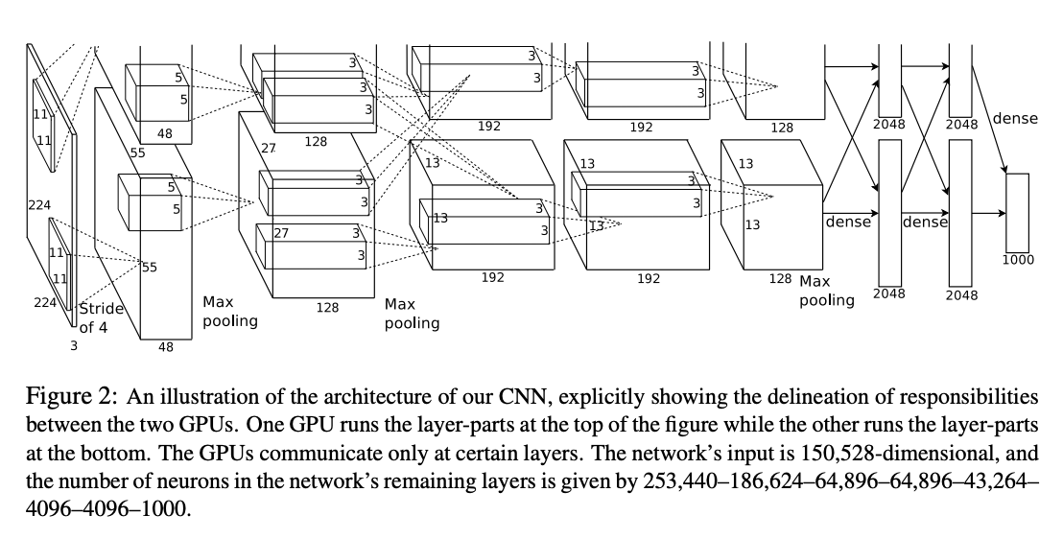
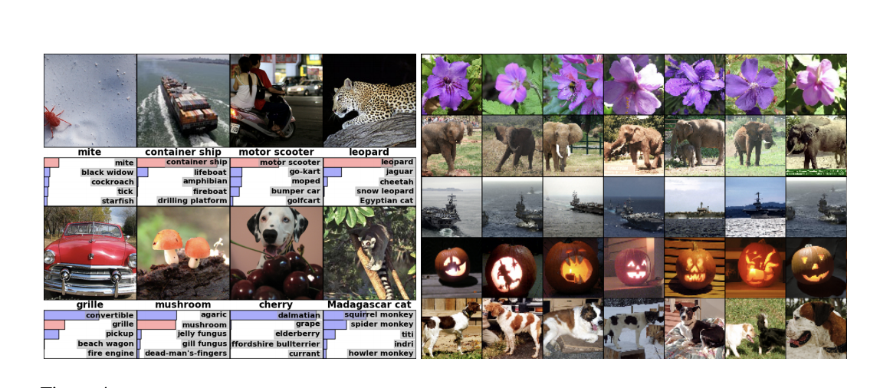
AlexNet 2012
Trained with ImageNet, Winner of the 2012 IMAGENET CHALLENGE
85% accuracy top-5 accuracy
Trained on multiple GPUs

Slide 28
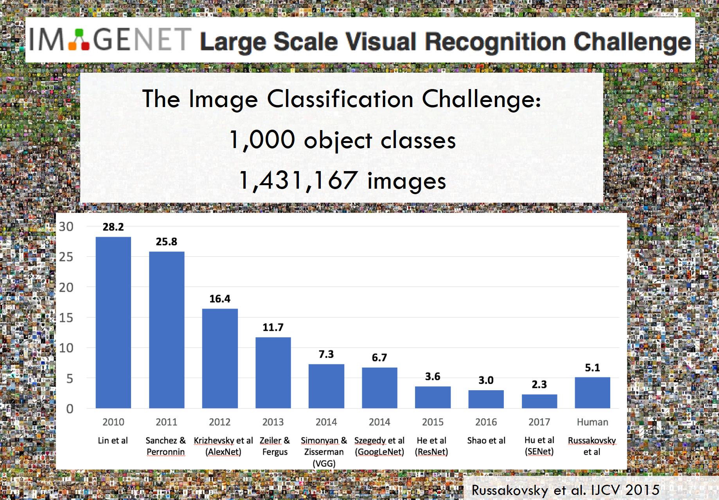

Slide 29
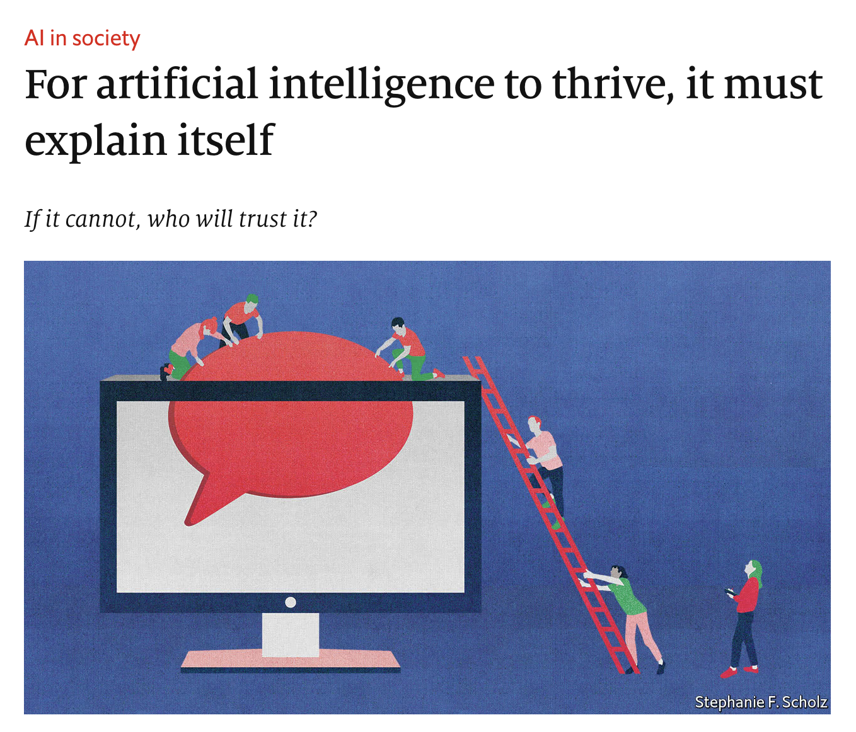
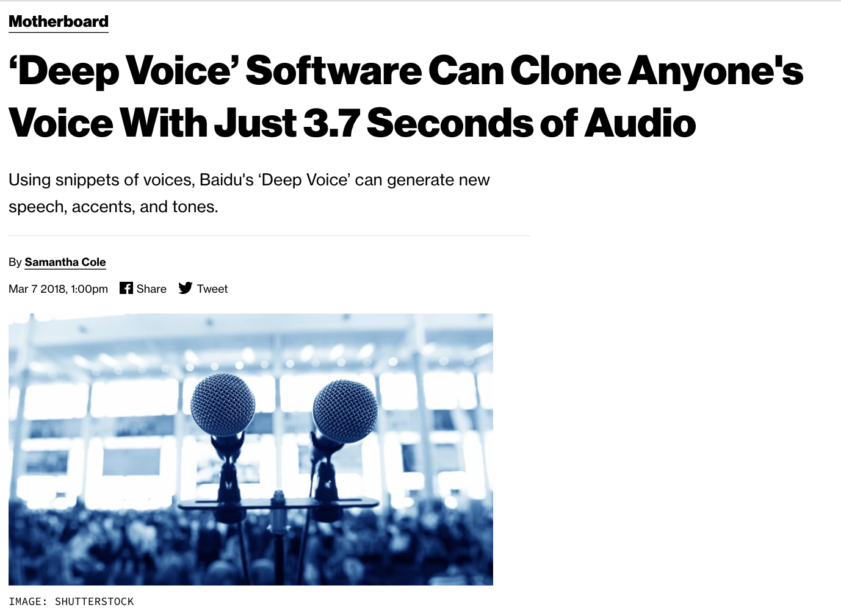
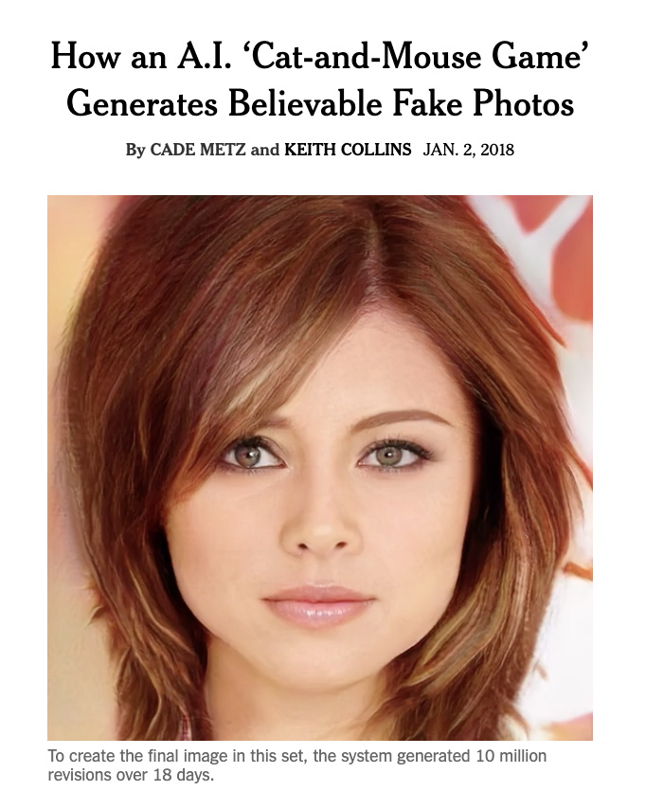
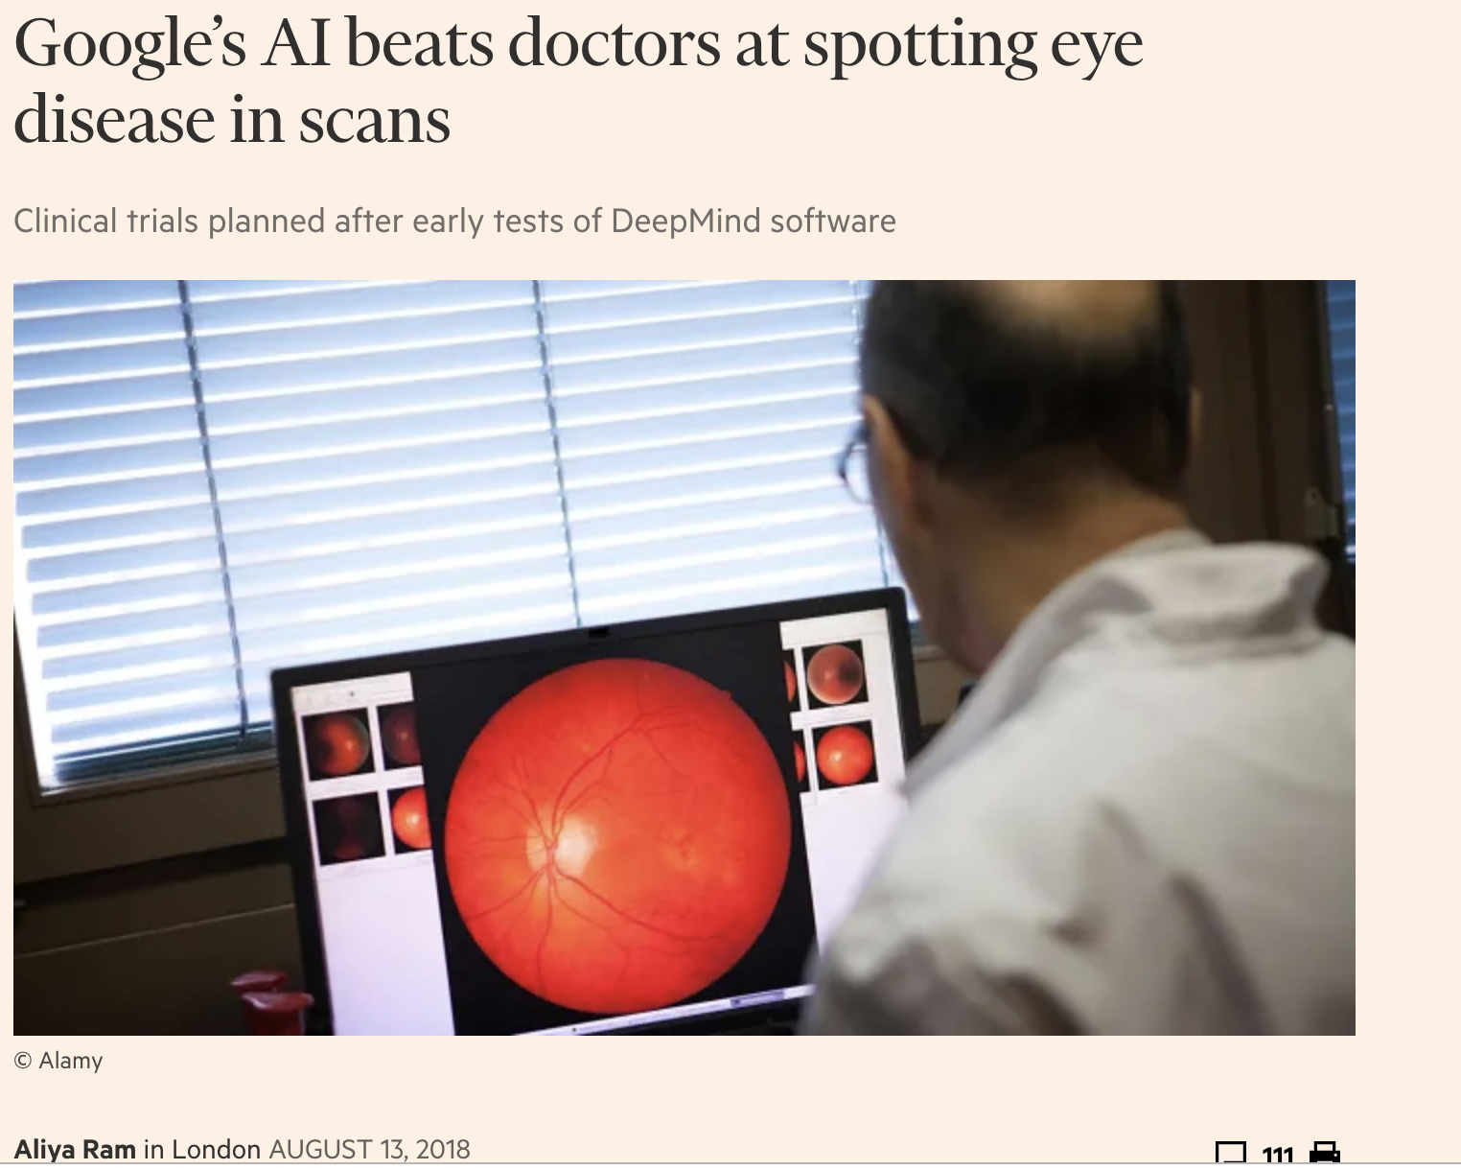
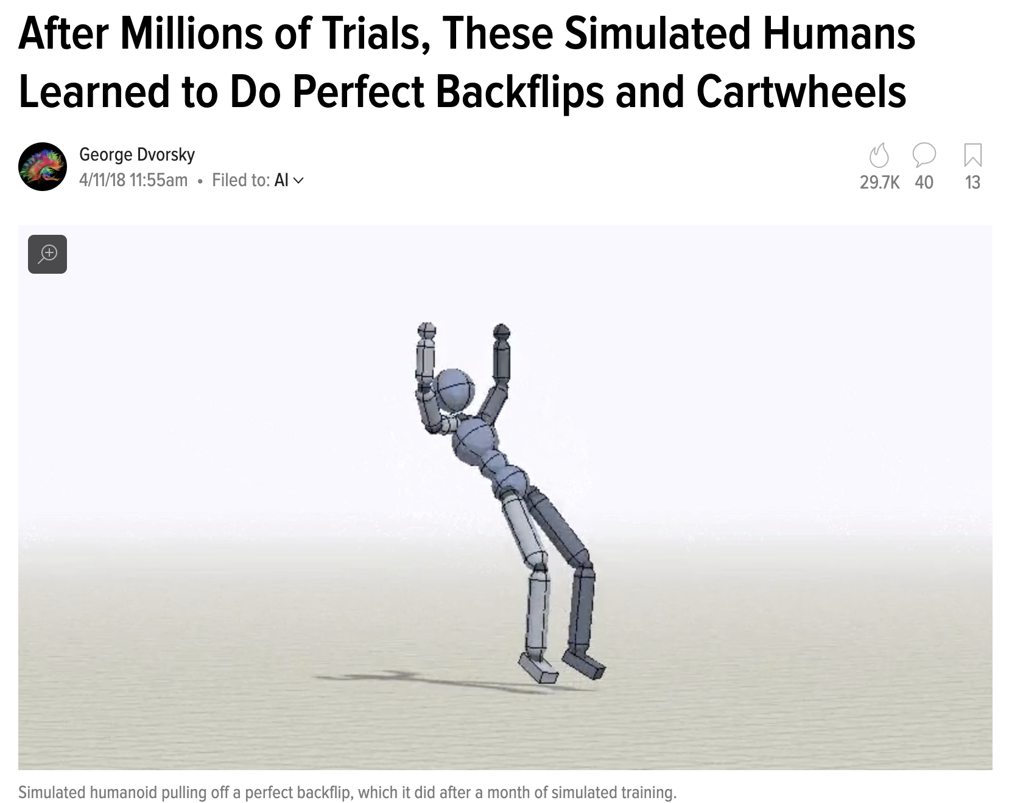
The rise of deep learning

Slide 30
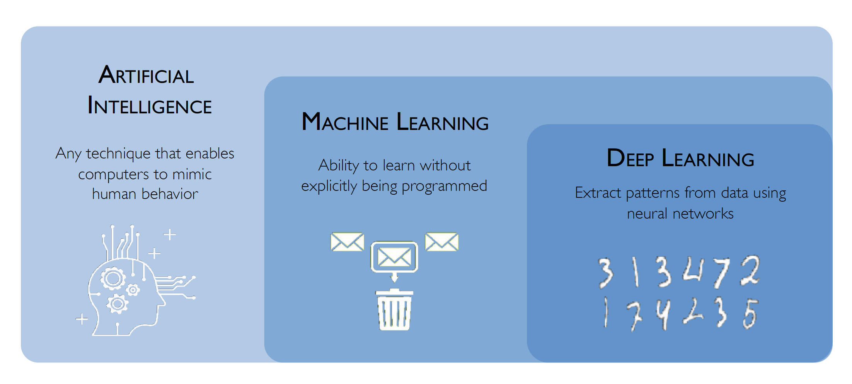
What is deep learning?

Slide 31
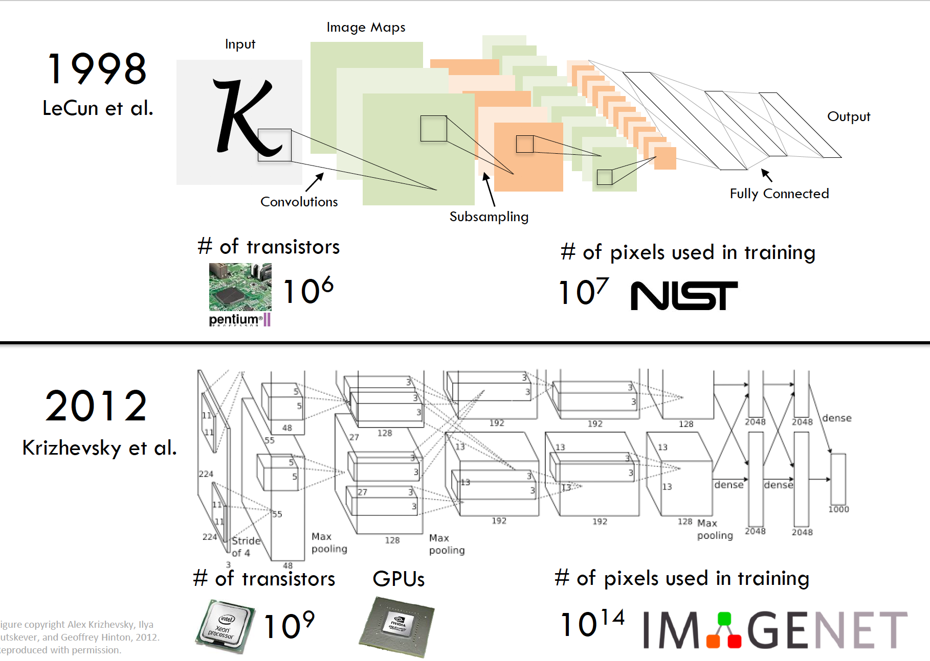

Slide 32
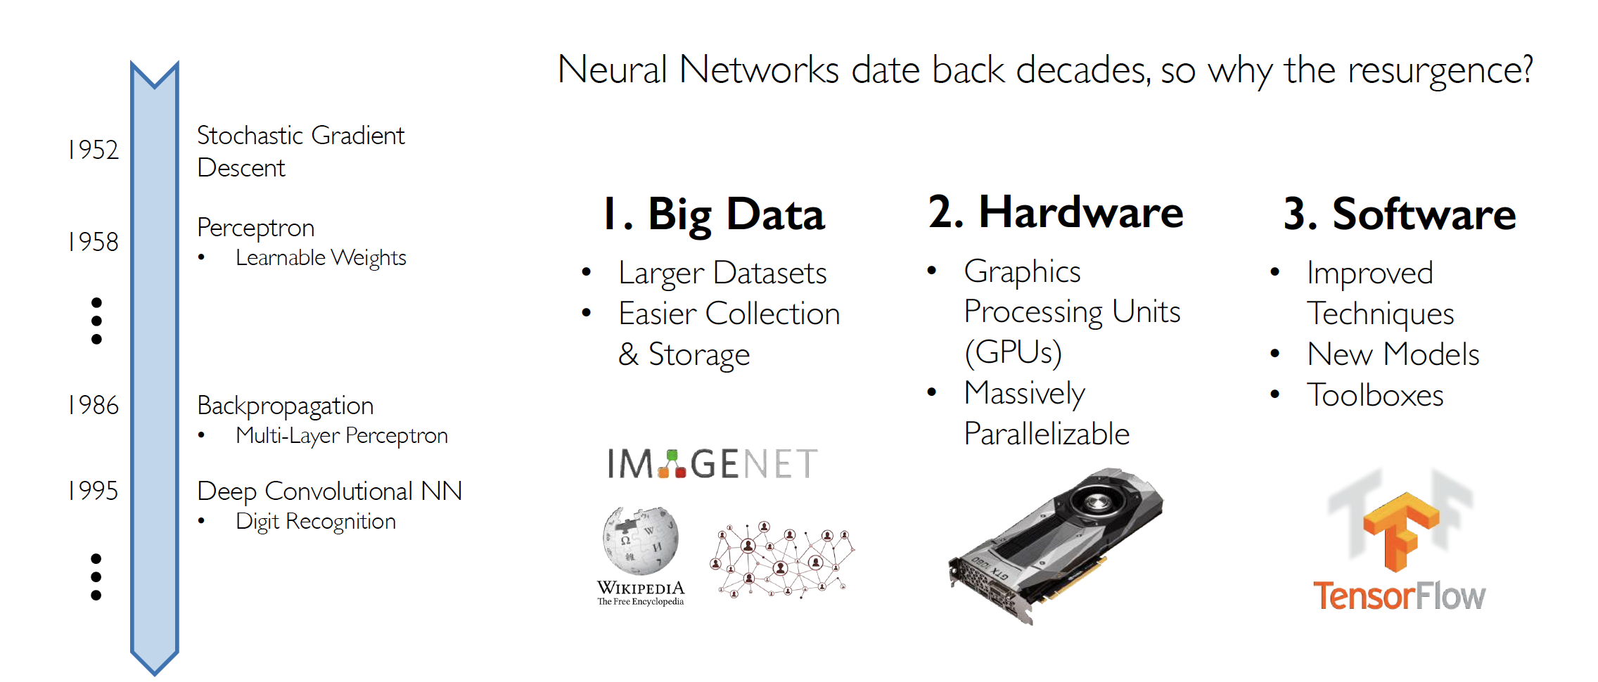
Why now?

Slide 33
Ingredients for deep learning
Algorithms
Data
Computation (hardware, architecture)

Slide 34
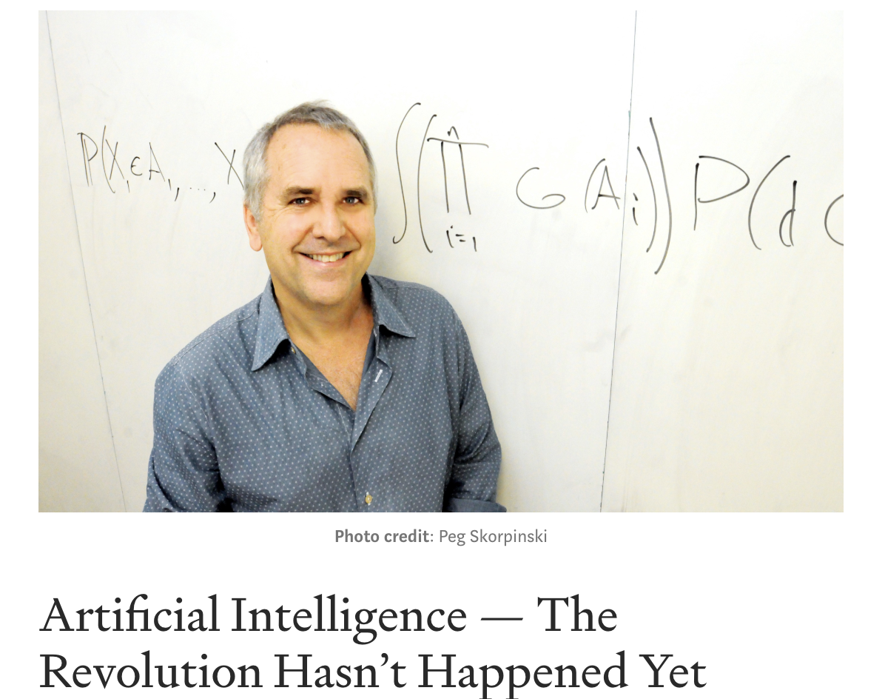
Skeptical view of current status of AI revolution (assigned reading)
Discussion:
What is the difference between ”AI” and “Machine learning”?
According to the author, what aspects of the “AI” are most successful so far?
What are some of the skepticism the author raised for the current “AI” revolution?
What algorithm is considered the ”core” of AI revolution?

Slide 35
Who am I?
Bei Xiao, Assistant Professor of Computer Science, Vision Reseacher (bxiao@american.edu)
Research interests:
Human vision
Computer vision
Computer Graphics
Specifically, I am interested in
Human and machine estimation materials of objects
Tactile visual integration
Perception in Virtual Environment (VR/AR)
Using g human intuition to guide machine algorithm

Slide 36
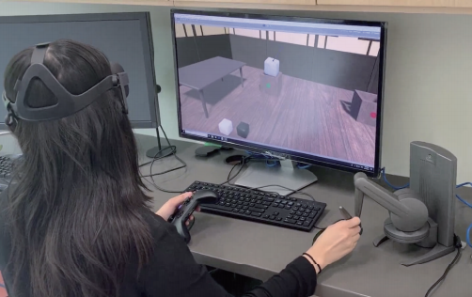
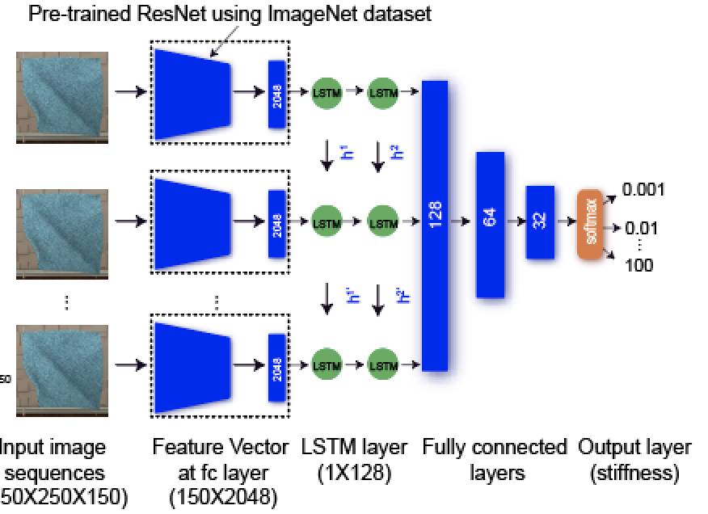
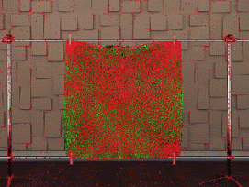

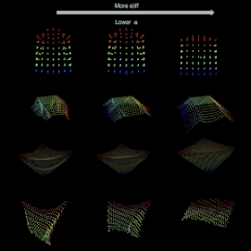
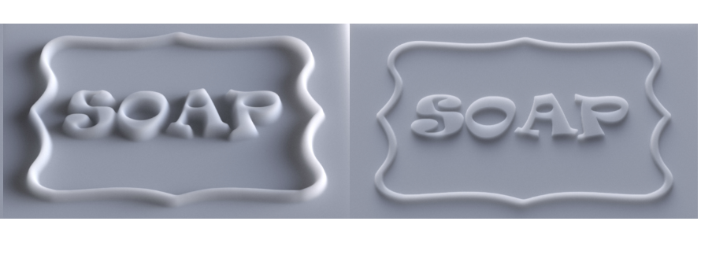
Current research in Xiao Lab
Interactive Material Perception in VR/AR
Deep learning cloth properties
Motion and perception of deformable objects
Tactile and vision integration
Simulate deformable objects
Perception of translucent materials

Slide 37
Pre-reqs
Some math: especially probability, college, calculus and linear algebra
Proficient with at least one high-level programming languages
Some basic backgrounds in image processing/signal processing

Slide 38
This course is still about computer vision with an overview of on deep learning
Part 1 (August 26-September 23rd): Overview of Computer Vision: Image formation, Camera, Light and color, Signal processing, Statistical modeling of images, Basic math tutorials, Numpy tutorials.
Part 2: (September 30-October 17th): Basic machine learning. Linear classification. Loss function. Tensorflow tutorials.
Part 3 (October 21st- December 9): Deep learning architectures and applications in CV. Neural networks, multilayer perceptron, backpropagation, CNNs, RNNs, GANs, representational learning, GPU computing and HPC.

Slide 39
Pre-course survey: diverse backgrounds!
Good math: 75% have taken probability and statistics. 62% has taken calculus, and 75% have taken linear algebra.
Mixed-python programming: 12.5% have never programmed in Python. 38% has done some Python after 280.
Numpy: 37.5% are beginner level.
Lack of computer vision: 50% have never done image convolution. 25% have never done image processing.
Mixed machine learning: 50% has taken machine learning.

Slide 40
How do I respond to this?
A review of basic computer vision, with a focus on an signal processing, multiscale pyramids, image formation, statistical modeling of images.
A tutorial and homework on basic image processing with Numpy.
A tutorial of basic machine learning methods and algorithmic foundation of neural networks.
Expectation: if you have taken Computer Vision (CSC476), You might have heard some of the content we will cover in the first 3 weeks. You can help your follow classmates by answering their questions or discuss the topics.

Slide 41
How do you get started?
Do the tutorials on Python and Numpy in the first two weeks
http://cs231n.github.io/python-numpy-tutorial/
https://sites.engineering.ucsb.edu/~shell/che210d/numpy.pdf
Read Computer Vision (Chapter 3) as much as you can.

Slide 42
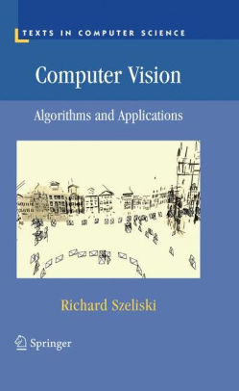
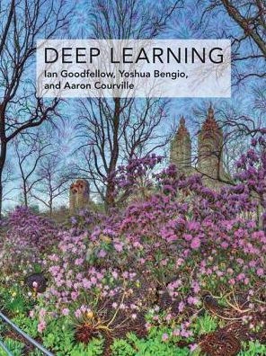
Textbooks (both have online versions)

Slide 43
Course communication
Updated slides/demo code/reading/ will be posted on course GitHub page:
https://github.com/fruittree/CSC496_2019F
Homework assignment and submission, announcements, grading will ONLY be happen in blackboard.
Restrict your questions of homework in office hours. If you can’t make to office hour, schedule with me with a 24 hour notice.

Slide 44
What is office hour used for?
Office hour is for?
Ask specific questions about contents covered in lectures or any course related content.
High-level discussion of projects and algorithms.
Ask well-formed questions about topic in computer vision, deep learning, and software/hardware tools.
Express concerns, ask for advice in how to learn better, and give feedback on the course.
Office hour is NOT for:
Go through lecture slides if you missed the class.
Debugging homework solutions.
Installing softwares (you can still ask specific questions)

Slide 45
Grading
65% homework projects (5-6 projects)
10% mid-term (in-class) closed book exam
15% Final project
5% in-class quiz
5% attendances. Missing one class will result in 2% reduction of the total grade (reasons accepted, sickness, pre-registered sports, and religious holidays).

Slide 46
Late Policy
We do not accept late submissions for this course. Homework is typically due 11:59pm. The submission deadline has a 24-hour soft cut-off; after midnight, submissions are penalized 5% per hour late round up to the next hour. So, you turned it in 2:59am. You will get 3 hours penalty with a 15% point reduction. There is no negotiation about this.
Homework CANNOT be submitted via Email. Only homework submitted to Blackboard will be graded. All the technical issues will have to be resolved earlier than the deadline (e.g. if data is too big you are allowed to submit a link of dropbox to download). It is your responsibility to make sure all of your code compile and run.

Slide 47
Collaboration Policy
No sharing of code/solutions among students (unless team work). However discussing general strategies is fine.
No copying from the Internet (GitHub, etc) unless specific by instructor. Everything you submitted should be your work.
No “detailed” walk through of homework project by a tutor, another student, etc. You can come to office hour to discuss with me. Only high-level discussion is allowed.
No posting homework to public websites before one hour after the deadline.
Turning in something non-perfect/incomplete is better than violate the honor code.

Slide 48
Softwares
On your laptop:
Main tools,: Python 3, tensorflow with keras.
Pip install Jupyter, OpenCV, Tensorflow, matplotlib, Numpy.
If you use Anaconda, you still have to install Tensorflow.
Next week, we will learn how to set up virtual box to avoid compatibility issues.
GPU computing resources
AU HPC cluster GPU node (available in October). Tutorials offers in October by CTRL.
One GPU computer available in Room 203.
AWS educate.

Slide 49
Office hours (DMTI 204)
Monday: 4pm-5pm (Away October 28th). The office hour on that day will be moved to the previous Friday.
Wed: 3:30pm-5pm (Traveling September 18th). On that day the office hour will be moved to the morning.
If you can’t make the office hours, you can schedule with me another time to meet up. I need at least 48 hours notice to respond to your email for the scheduling.

Slide 50
Take-home exercise
Check blackboard for tutorials
Install Numpy, Scippy, skimage, matplotlib.
You can install Anaconda 3
Numpy tutorial
https://stackabuse.com/numpy-tutorial-a-simple-example-based-guide/
https://www.youtube.com/watch?v=xECXZ3tyONo

Slide 51
Next class:
Simple visual system
Image formation
Pin hole camera
Python/Numpy primer

